Slide 1



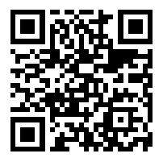
WELCOME TO PARENT AND STUDENT ORIENTATION 2025-2026
Complete PCSB Forms Online!

Slide 2
General Information
Disston Academy for Progress & Enterprise is a Pinellas County Schools’ Educational Alternative School. This status gives us special exemption to support scholars who need “Something Different”.
We follow the Pinellas County School Board Policies, including the Code of Student Conduct.
Operating Hours: 7:00AM-2:30PM
Student Hours: 7:15AM-1:45PM
Serving scholars in grades 9-12 and overage middle school scholars
How is Disston Academy Different?
Blended curriculum model.
Accelerated graduation model.
Fully staffed student services team with trauma informed care systems.
Uniforms & structured check-in processes.
Pinellas County Schools best kept secret!

Slide 3



Full Scale Student Services Support
As an Educational Alternative School (EAS), we support a population of scholars who are 100% trauma exposed and nearly 90% trauma engaged. Our typical student is…. A-typical.
To counter environmental and social exposures, we provide many services. Disston Academy provides a setting that fosters the optimal development of our scholars through connective, empathetic, and communal structures. Some services we provide are:
Schoolwide Restorative Practices
Positive Behavior Interventions and Supports
Onsite social worker, psychologist, behavior specialist & counselor
Clothes for Kids referrals
St. Petersburg Free Clinic referrals
Girlfriends & 5000 Role Models
Individual counseling & small group facilitation

Slide 4

WHO’S WHO at DISSTON ACADEMY
School Administrators
Etje Ramdohr - Principal
School Instructional Staff
Natalee Cleveland – Math 5-9, Algebra 1, Safe
Club, and Multicultural Advisor
Pamela Douglas – Math, Science, and English
6-12
Elizabeth Hassler –Science
Alicia Higgins – Math 6-12 and SWAT
Natasha Sandman – Business Education,
Social Studies 6-12, and Tech. Coordinator
Nakkia Sly- Social Studies, Title 1 Coordinator,
Family Liaison, and Senior Advisor
Teniquiana Smarwt – ESE and Girlfriends
Erin Savage– English 3 & 4
Elective Instructional Staff
Business Edu. – Natasha Sandman
PE – Kyle Sand
Health – Erin Savage
School Paraprofessionals
Shannan Nichols
Vonda Young
School Support Staff
Diana Gregory - Secretary/Bookkeeper
Michelle Ba - Data Management Tech
Rhianna Alejo - Clerk Specialist I
Dr. Eartha Mims – D.A. and Teleschool
School Counselor
Coach Blackmon - Behavior Specialist
Officer Conyer- S.R.O.
Devlin Pippert - School Social Worker
Melanie Gillett- School Psychologist
Cathy Johnson- Registered Nurse
David Willis – Technology Technician

Slide 5

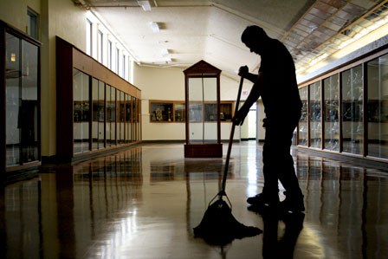
Disston Academy’s Operational Staff
Rochi Morand - Head Plant Operator
Daryll Russell- Night Foreman
David Rhett- Plant Operator
Thi Huynyh Duong - Plant Operator

Slide 6
School Vision and Mission
VISION- 100% student success through preparation, performance and pride.
MISSION- Disston Academy’s school mission is to educate and prepare each student for college, career and life through the expectation of performance and infusion of pride.
MOTTO- Ascending the ashes, soaring to Greatness!

Slide 7

Phoenix P.R.I.D.E Expectations
Prepared
Responsible
Invested
Determined
Engaged

Slide 8
Phoenix Pride
Prepared- Always be prepared for excellence in education!
Responsible- Lead in the classroom & workplace!
Invested- In the success of all within our school community!
Determined- Achieve greatness in academics and advancement in life!
Engaged- Excellence through equity & restoration!

Slide 9
Positive Behavior Supports (PBIS)
Goal: To promote school safety and a positive environment within the school.
Rewarded Behavior Examples: Attendance & punctuality, adequate course progress, dress code, demonstrating PRIDE!
Activity Examples: Tailgate Cookout, Talent Show, School Dance, Flag Football, Recreation Room, Kickball, Pizza Parties, E-games, & More!

Slide 10

Restorative Practices Overview
What is it?
Restorative Practices principles emphasize the importance of positive relationships as essential to building community and involves processes that repair relationships when harm has occurred.
What does it do for my student?
Providing a setting that fosters the optimal development of its members through empathy, supportive and community building.
Examples
Empathetic Listening
Using “I” Statements
Restorative Questioning
Restorative Conversations (Chats)
Proactive Restorative Circles

Slide 11
Required Supplies
All Scholars will receive a Disston Academy Backpack, PCSB Laptop, Laptop Charger & Binder. Daily use of these items is a requirement of enrollment.
Only Disston Academy Backpacks will be permitted inside of the building.
Pens, Pencils and paper will also be given to the scholars; however, they are welcome to bring their own.

Slide 12
Entry & Release from School
School Hours are 7:00 AM-2:30 PM
Scholar Entry – Scholars will enter the building from the bus circle in building 1 or building 3 from 7:00AM-7:10AM.
Parent Drop Off - Please drop your scholar off in the car circle ONLY. They will walk around to the bus circle and enter at their assigned building.
Late Entry - Scholars are checked in at the front office. Scholars not checked in before 7:15 AM are considered tardy. Scholars arriving after 8:00AM must be signed in by a parent or guardian, in person.
Personal items - Including but not limited to lunch, snacks, purses, clutches and backpacks will be searched and collected on arrival. Please bring your food and drink for lunch in one bag so it is easier to label and track.
Early Release – All scholars are required to get a Permit to Leave(PTL).
Permits to Leave are granted beforehand and all scholars, including those over 18 must have parent/guardian notification and/or approval.

Slide 13

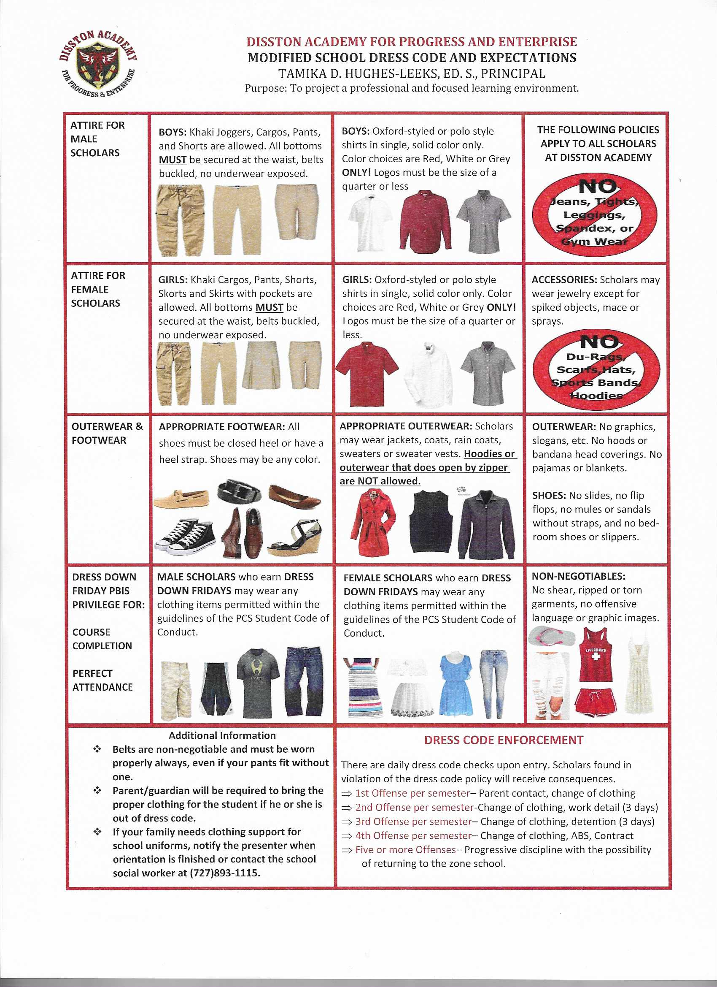
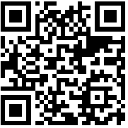
Student Dress Code
Polo or oxford (collared) shirts in solid colors of red, burgundy, white, black or grey.
Pants, chinos, cargos, shorts, skorts or skirts in the color of khaki/tan or black only. NO JEANS
Belts are a mandatory requirement of the dress code.
Open-heels shoes, flip-flops, slides and bedroom slippers are not permitted! Distressed, damaged, or torn clothing are also not permitted!
**If your scholar needs clothing support please see Ms. Pippert for a referral to the Clothes to Kids Store.
Dress Down Opportunities
Scholars who pass a class can dress down every Friday during the following month. Scholars who have perfect attendance for a month can dress down every Monday the following month! Clothing must meet the PCSB code of conduct requirements.

Slide 14

Disston Academy Electronic Device Policy
Scholars may NOT possess a cellular telephone, Smart Watch or other electronic device. Scholars are strongly encouraged to leave cell phones and other electronic devices at home. If it is necessary for a scholar to bring a cell phone to school, the scholar MUST turn in the phone upon entering the building whether they are asked by a staff member or not.
If a scholar is caught with an electronic device, it will be confiscated, and the parent or guardian will have to retrieve the item from school administration.

Slide 15
Electronic Devices Updates from the State of Florida

Slide 16
Florida House Bill 1105 is now in effect, and our district has updated the Code of Student Conduct accordingly. Middle school students are not permitted to use or have visible any cell phone, earbuds, headphones or other wireless devices during the school day (bell to bell). This includes use for instructional purposes, unless specifically allowed under an IEP, 504, medical plan, or emergency situation.

Slide 17
Transportation Options
Scholars who live outside of the two (2) mile radius will be provided a Pinellas County School Bus assignment at an arterial location.
PSTA offers free transportation to scholars with a picture student ID.
Scholars who intend to drive to school must meet all of the requirements established on the Disston Academy Parking Permit Application. This includes but is not limited to proof of a valid state driver’s license, proof of insurance, paid parking permit fee and a consistent attendance record. Documents and fee must be submitted to Ms. Gregory to obtain parking permit.
Any scholar vehicle parked at Disston Academy without an official parking permit may be subject to towing at owner expense without prior notice.

Slide 18
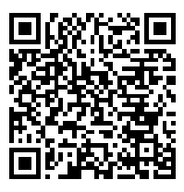
….But we still need your applications!
Food Services at Disston Academy
Disston Academy is a recipient of the USDA Community Lunch School Program.
This means all scholars are provided breakfast, and lunch free of charge!
Please go to www.myschoolapps.com or complete a paper application before you leave!

Slide 19
Medications in the School Setting
Pinellas County Schools encourages that all medication be given at home. If this is not possible, the PCSB guidelines on the following slides will be enforced.

Slide 20
PCSB Medication Guidelines
Scholars may NOT transport medications to or from school.
Parent/Guardian must complete a medication form and/or obtain MD signature/order
Please bring meds to school pre-cut if necessary.
Parents/Guardians must notify the school of any changes in medication dosage, time, etc. (New form must be completed annually)

Slide 21
PCSB Medication Guidelines
Parents are required to pick up and sign out any unused or unnecessary medication at the end of the school year or upon request. (Any medications left at the end of the school year will be destroyed)
Over the counter medications require both a parent signature and written health provider prescription.
Pharmacy label must be intact for prescription meds
Medications MUST be counted with the school nurse upon drop off of the medication as well as the pick-up.

Slide 22
PCSB Medication Guidelines
Narcotics, barbiturates, and non-FDA regulated non-prescription herbal products will NOT be given at school.
Questions or concerns, please call the school nurse at (727)893-1115.

Slide 23

Personalized Learning Options
Facilitated Digital Support
100% digital course including assignments, study guides, quizzes & assessments.
Coursework is accessible at anytime, from any web enabled device.
A teacher certified in the content provides support and monitors assessments in person.
Scholars work at their own pace and have the capacity to accelerate and complete courses in less time than a traditional semester model.
Traditional Direct Instruction
State assessed core subject areas with a focus on Middle Grades, Algebra 1, Biology, English, Geometry & US History
Instruction provided through lecture and collaborative structures.
Traditional textbooks and supplemental materials.
Access to laptops and Clever applications for remediation and supplemental support.
Blended Instruction
Small class size instruction
Instruction and learning occur through different modalities including digital, project-based, and traditional.
Lectures and targeted lessons for review and reinforcement of complex skills and structures in support of the digital course.
Accelerated Pacing.

Slide 24
Career & Technical Offerings
Marketing Essentials blends theory and practice to facilitate immediate implementation and impact. Students will learn to develop strategic marketing with sales and customer plans. A review of the marketing environment is used to help develop the segmentation, targeting and market positioning strategy for implementation along with the marketing mix (product, price, place and promotion). The goal is the identification and delivery of organizational competitive advantage and customer satisfaction – key to long-term revenue growth, profitability and success.
Digital Information Technology is designed to provide a basic overview of current business and information systems and trends, and to introduce students to fundamental skills required for today's business and academic environments. Emphasis is placed on developing fundamental computer skills. The intention of this course is to prepare students to be successful both personally and professionally in an information-based society. Digital Information Technology includes the exploration and use of databases, the internet, spreadsheets, presentation applications, management of personal information and email, word processing and document manipulation, HTML, web page design, and the integration of these programs using software that meets industry standards. After successful completion of this core course, students will have met Occupational Completion Point A, Information Technology Assistant - SOC Code 15-1151.

Slide 25
CAREER PREPARATION
COLLEGE TOURS
SIGNING WITH ST, PETERSBURG COLLEGE, AND PINELLAS TECHNICAL COLLEGE
UNITED STATES ARMED FORCES
NATIONAL AVIATION ACADEMY

Slide 26
Diploma and Graduation Options
Standard Diploma Options
18 Credit Option (Career Prep)
24 Credit Option (College Prep)
Dual Enrollment Options
Commencement Options
Zone School (March Deadline)
Disston Academy
Countywide Summer

Slide 27
Graduation Requirements for Both Credit Options
Four (4) Credits of English: English 1, 2, 3, and 4
Four (4) Credits of Math: Algebra 1, Geometry, and two more selected Math credits
Three (3) Credits of Science: Biology and two more selected Science credits
Three (3) Credits of Social Science: World History, US History, Economics (.5), US Govt. (.5)
One Credit of Performing Arts/Practical Arts Credit
Three (3) credits of selected Electives (Reading, Business Education, PE, HOPE, etc.)
Half credit Personal Financial Literacy (.5)
--------------------------------------------------------------------------------------------------------------------------
The additional requirements for the 24-credit graduation option are:
One Credit of Hope
Five (5) additional selected electives (these should include at least two consecutive credits in the same foreign language IF you wish to enter a university as a freshman, or if you wish to qualify for the highest Bright Futures Scholarship award)
https://www.fldoe.org/schools/k-12-public-schools/sss/graduation-requirements/

Slide 28
Dual Enrollment Options
Dual-enrollment options for Pinellas Technical College (PTC) and St. Petersburg College are available to students at Disston Academy.
Classes, books and all related fees are provided by Pinellas County Schools.
Scholars have to have good attendance and minimal discipline referrals.
Scholars have to apply by the end of the preceding school year (PTC)/semester (SPC).
Scholars who successfully complete courses will earn high school credit AND credit towards college-level credit and certification.
For PTC, scholars need at least a 2.0 (some programs require a higher GPA).
For SPC, scholars need at least a 3.0 except for specified courses, and they need to pass their CPT/ACT/SAT/CLT.
For enrolled scholars, transportation is provided to and from Pinellas Technical College.

Slide 29





Scholars need to pass one of these tests in Reading and Math in addition to earning all their credits to receive a diploma :
Additional Graduation Requirements

Slide 30
ACT/SAT Concordant Assessments
The SAT and ACT assessments are offered in school twice a year. The fees for these assessments are covered by the district.
Test Prep offered during the school day and through our Extended Learning Program so that scholars are prepared.
Additionally, ACT/SAT Boot Camp may be offered on Saturdays before designated test dates.
For more information about testing or test prep,
contact Administration.

Slide 31

Khan Academy:
High School
Full coverage on math standards
Social Studies
Growing library of science
Computer programming
Digital SAT prep
Growing library of AP courses

Slide 32
Practice Reading Everyday
Set a timer for 15 minutes a day and read a book, a physical, paper, book. Not on your phone.
Use the local library to find books your scholar is interested.
Digital & Audio books are available for checkout through the school district’s destiny website.
Increase the time every week by 1 or 2 minutes.
Read fiction and nonfiction.

Slide 33
Co-Enrollment
Scholars wishing to participate in athletics or other events at their zoned school may co-enroll with that school so long as all requirements for eligibility are maintained.

Slide 34
Let’s Review the Forms and Policies Together
Student Handbook QR Code
Parent/Student Acknowledgment Form
Dress Code Handout
Electronic Device Policy
Safe School Agreement
Where do I go for assistance
Student Calendar QR Code
Code of Conduct Acknowledgment Form
Residency Questionnaire
EAS Parent/Student Notification Form
Clinic Card
Home Language Survey
PCSB Medication Policy
Bring Your Own Device Agreement
Network/Internet Acceptable Use Agreement
Media Release Form
Directory Information Opt-Out
Title 1 Budget

Slide 35
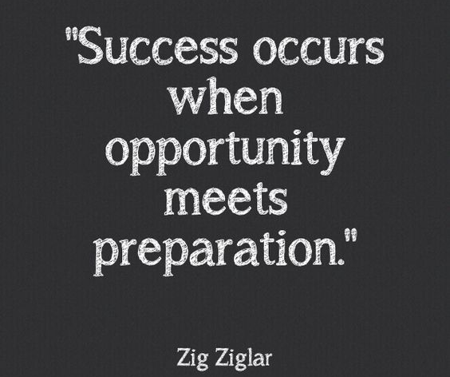
HOW CAN PARENTS HELP?
Become a coach by providing teachers your email address.
Review your scholar’s progress in each course, current GPA, and past due assignments.
Contact your scholar’s teacher if you suspect they may be off track.

Slide 36
Parent Conferences
Parent-scholar conferencing is highly recommended. This conference can occur in a face-to-face setting, via email, Microsoft TEAMS or telephone.
Arrangements can sometimes be made after hours on designated nights.
While it is always encouraged to communicate with individual teachers. Please contact Dr. Mims to set up a conference at least once per semester.
Parents may be required to attend conferences to address significant concerns with placement, attendance, or academic progress.

Slide 37
Title 1
What is Title I?
Title 1 funds aim to bridge the gap between low-income students and other students. The U.S. Department of Education provides supplemental funding to local school districts to meet the needs of at-risk and low-income students.
What can Title I Money purchase?
Teachers/Additional Staff
Before and/or after school tutoring
Supplies & Materials
Technology

Slide 38
Middle School Promotion Requirements
3 Courses of each core content area
Language Arts
Science
Social Sciences
Math

Slide 39
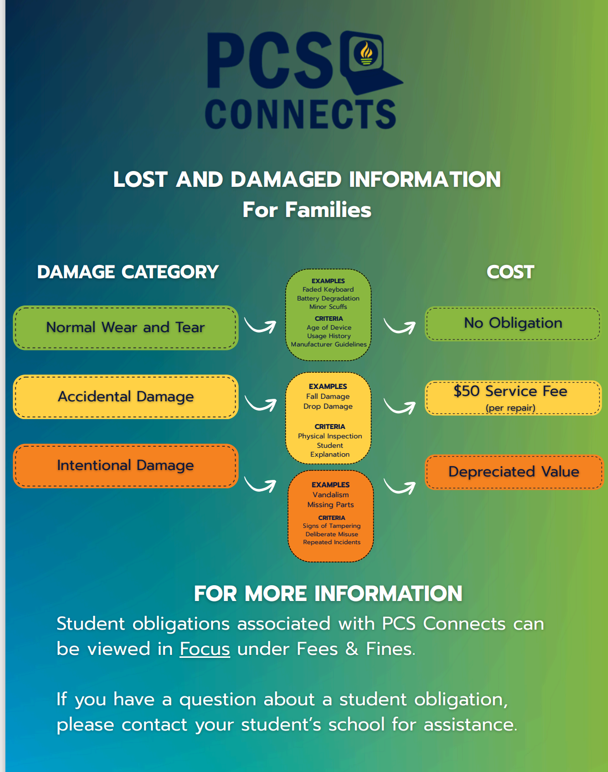

Slide 40

General Questions
Thank you for attending, we are excited to have you here!

