Slide 1
Welcome to Virtual Open House: First Grade
Gulfport Elementary
Principal Ashlea Zeller
Assistant Principal Christen Ku
“If we build it, they will succeed.”

Slide 2
First Grade Team:
Mrs. K-B (King-Byrnes)
Mrs. Bohrnsen
Ms. Killian
Ms. Troy
Ms. McCallister

Slide 3
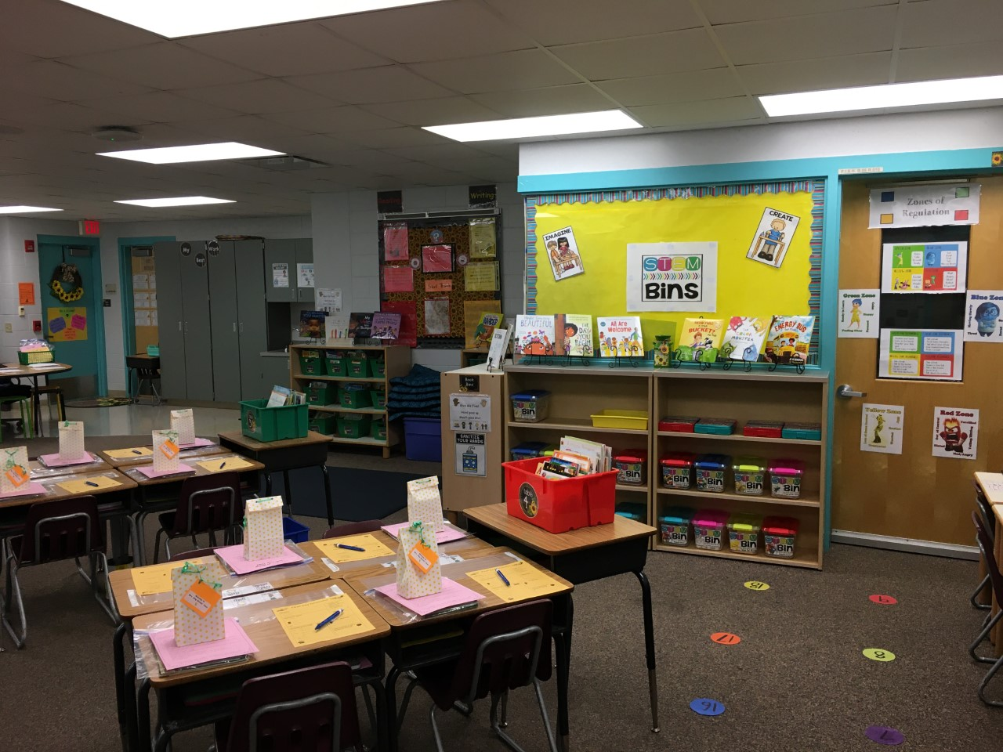
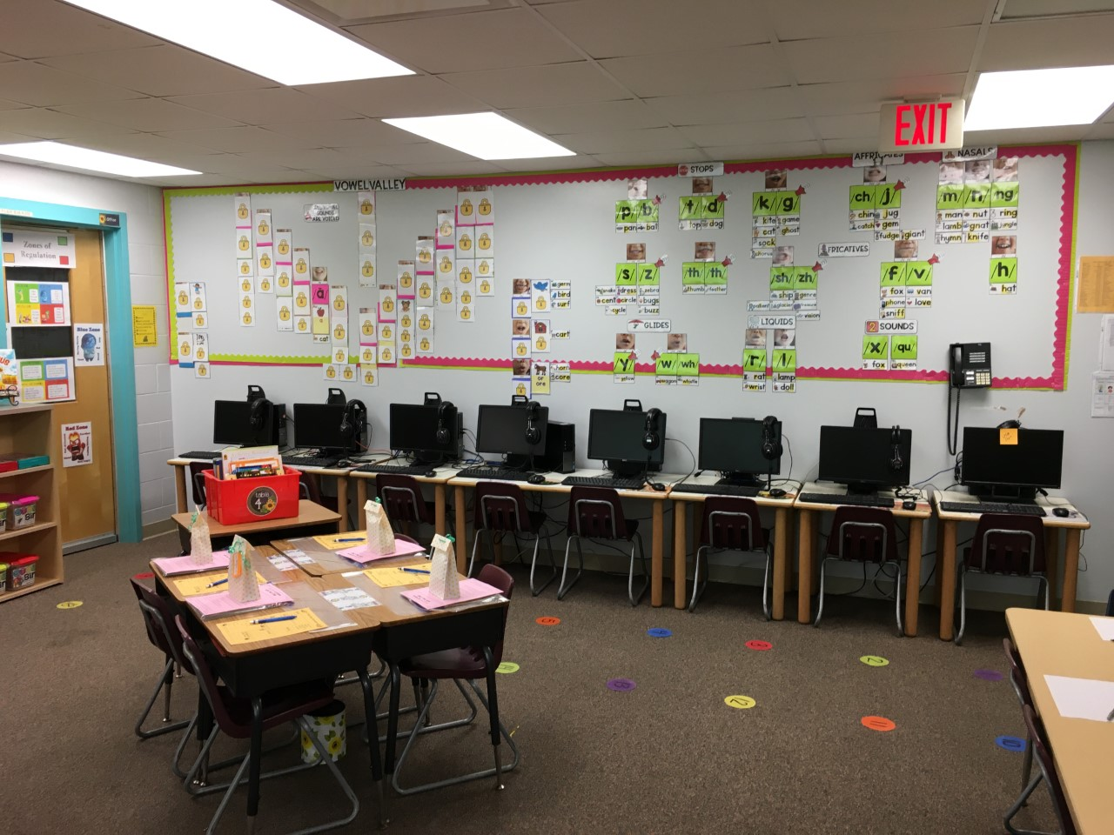
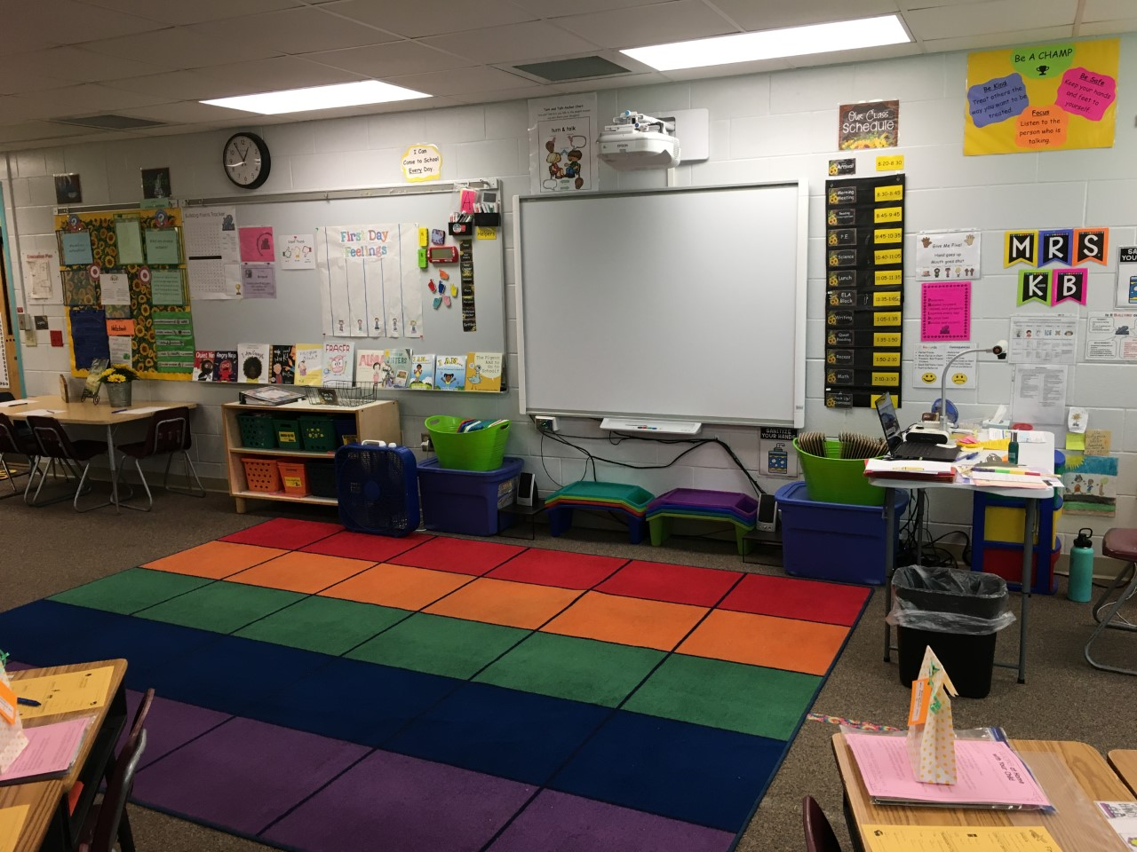
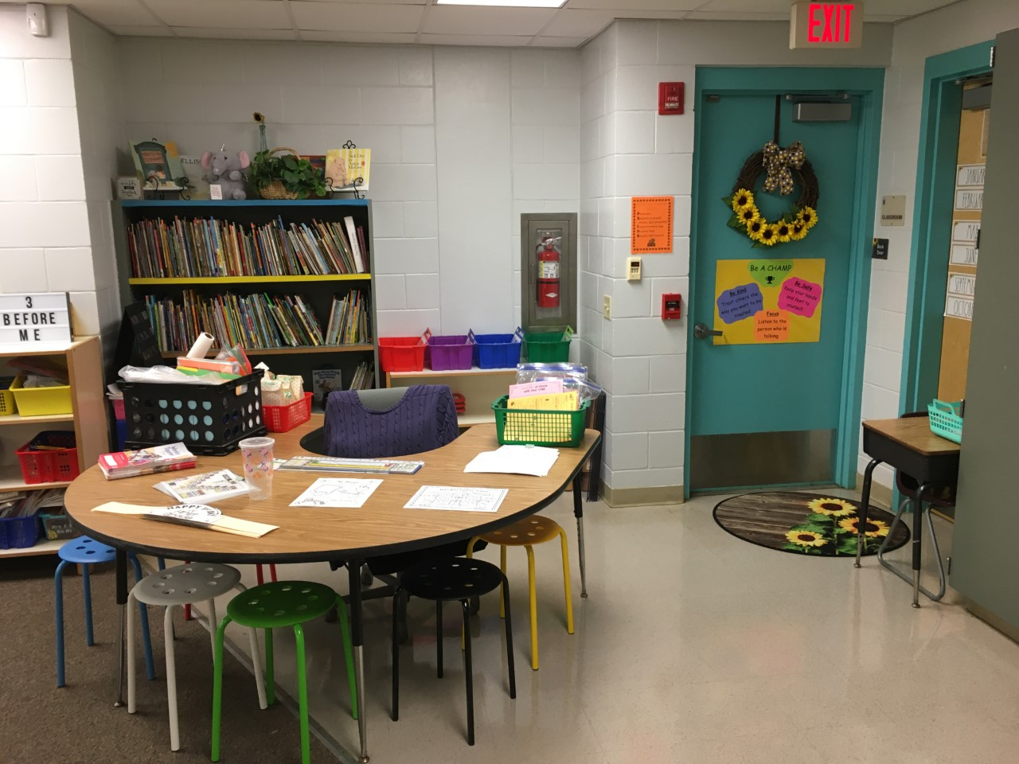
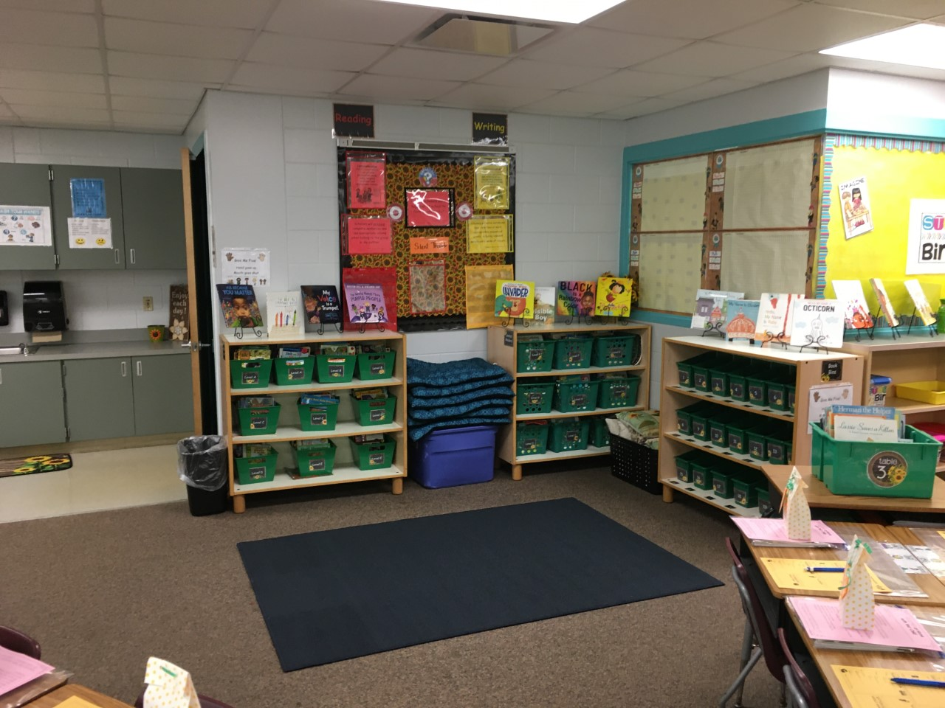
Mrs. K-B’s Classroom

Slide 4
Mission & Vision for 2021-2022
Raise student achievement in ELA, Math and Science
Promote a positive learning environment for all scholars
Scholars come to school every day ready to learn.

Slide 5
Behavior
PBIS School Wide Expectations
Whole School Common Language – PRIDE
Perserve
Respect yourself, orthers and property
Improve everyday
Do your best
Exhibit self-control

Slide 6
Attendance
Attending school every day is IMPORTANT
If you are not feeling well or exhibiting COVID like systems, please stay home and contact a medical provider.
Please call the front office to let us know if your child has tested positive or your child has been expsosed to someone testing positive.

Slide 7
Homework and Water Bottles:
Water Bottles are needed each day. Scholars ARE NOT permitted to drink out of the water fountain due to Covid.
Currently, first grade DOES NOT have any weekly homework.

Slide 8
Flow of the Day
School begins 8:30
Morning Meeting/News 8:30 – 8:45
ELA Intervention 8:45 – 9:45
Specials 9:45 – 10:30
Science 10:30 – 11:05
Lunch 11:05 – 11:35
ELA Block 11:35 – 1:05
Writing/Quiet Reading 1:05-1:35 and 1:35-1:50
Recess 1:50-2:10
Math Block 2:10-3:15
Pack Up/Dismissal 3:15-3:30

Slide 9
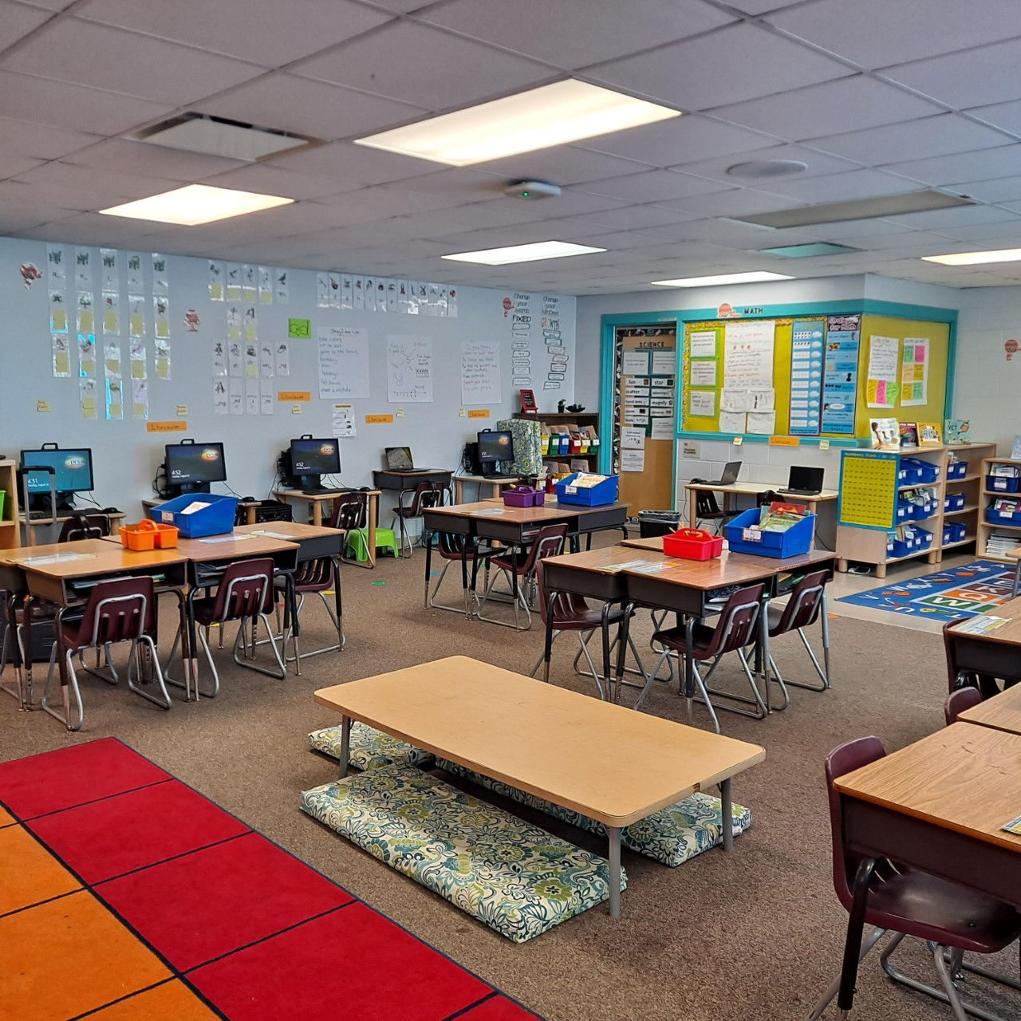
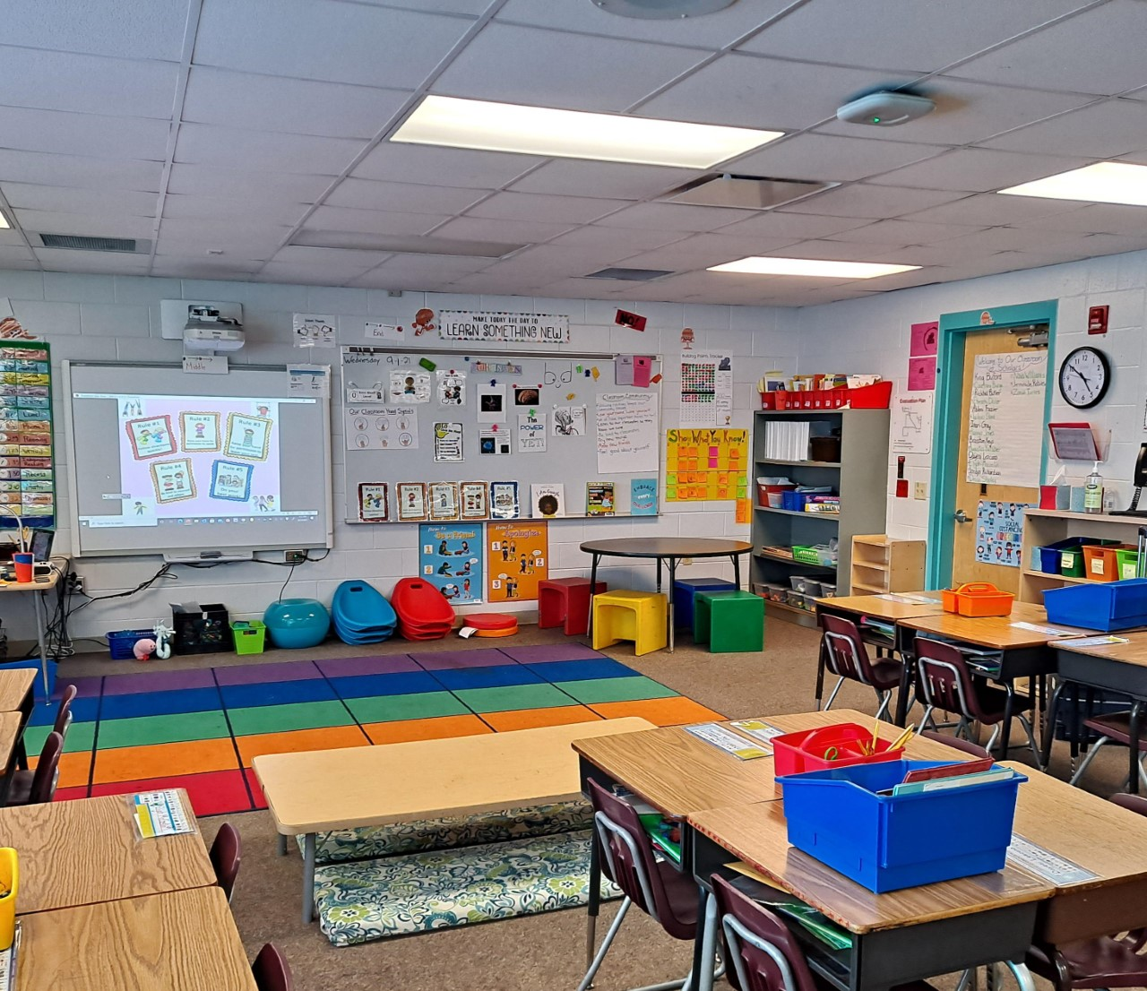
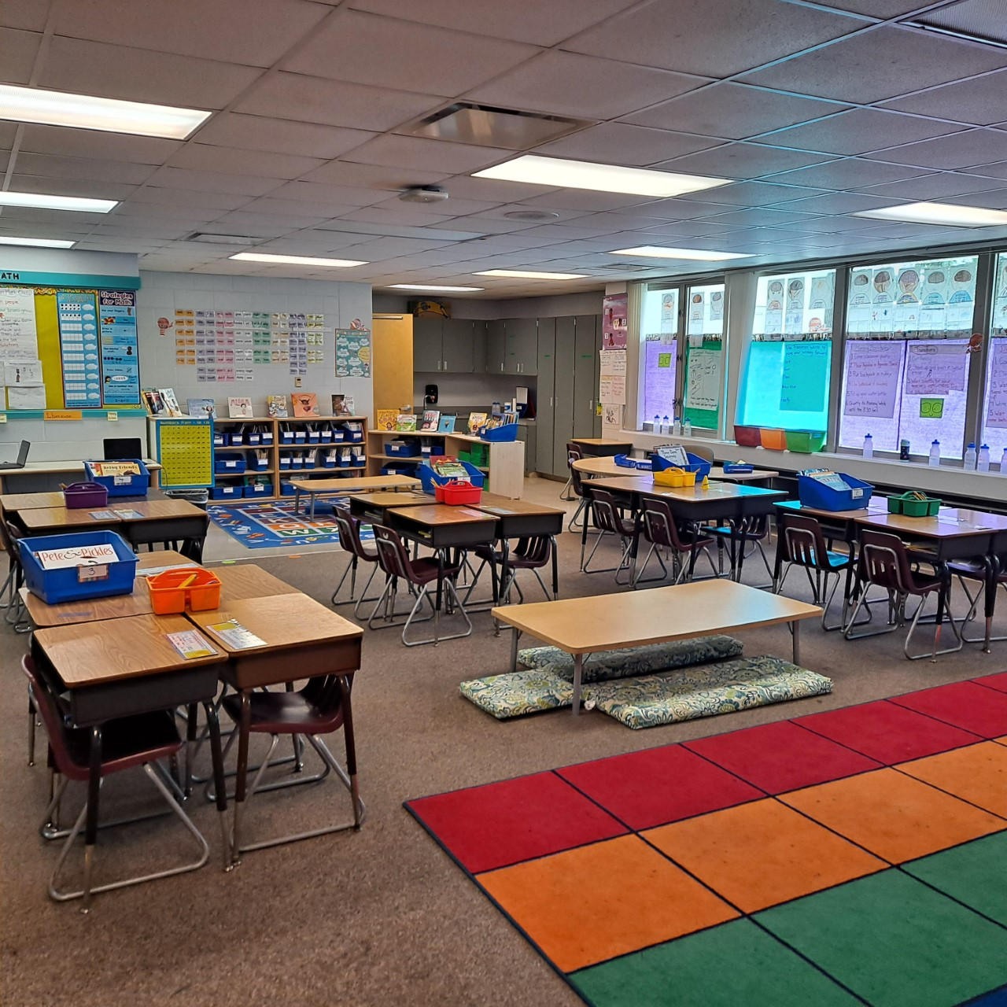
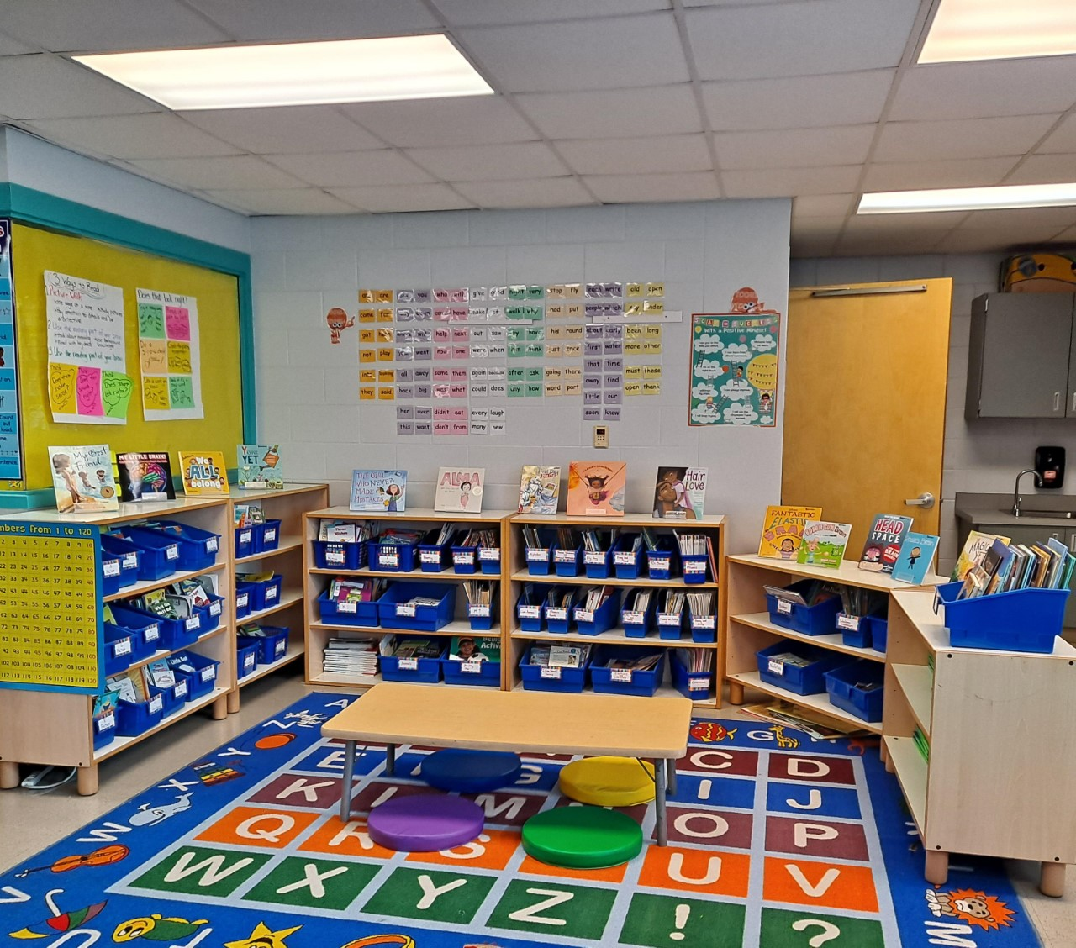
Mrs. Bohrnsen’s Classroom

Slide 10
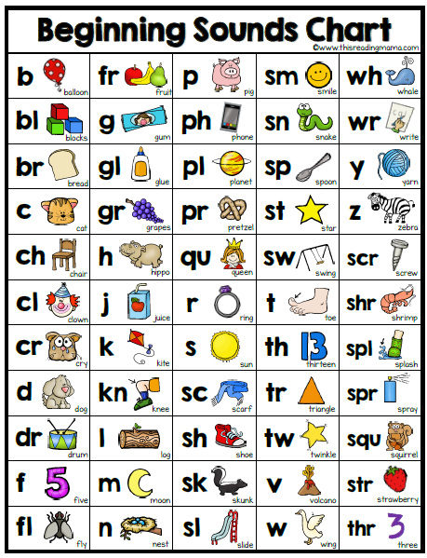
This year we will learn how to…
Read fluently
Read words by identifying the letter sounds. (Phonics)
Write complete sentences, personal narratives and fiction texts.
Write an opinion, informative, and explanatory piece.
Comprehend subject matter
Use clues from illustrations, and prior knowledge to understand readings

Slide 11
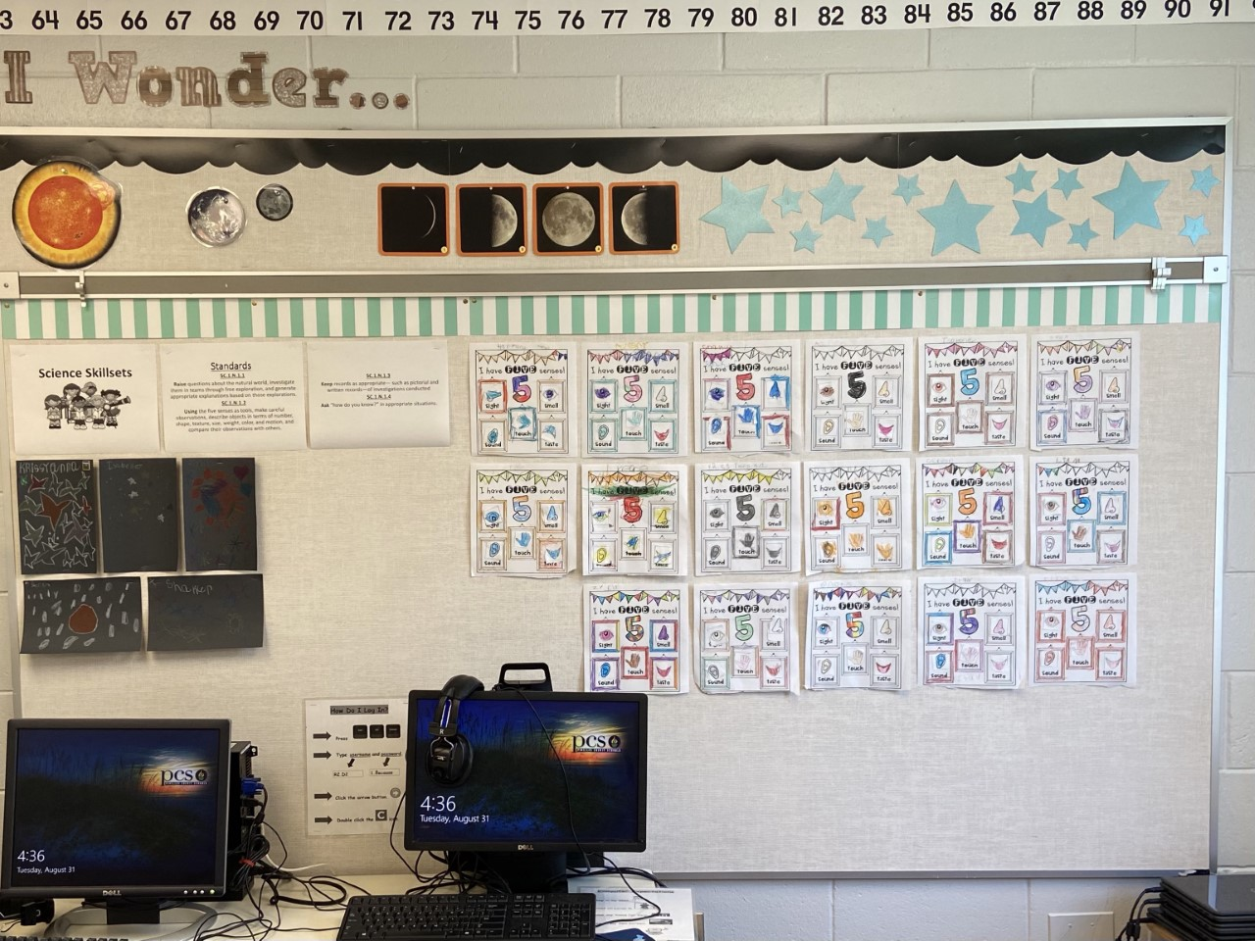
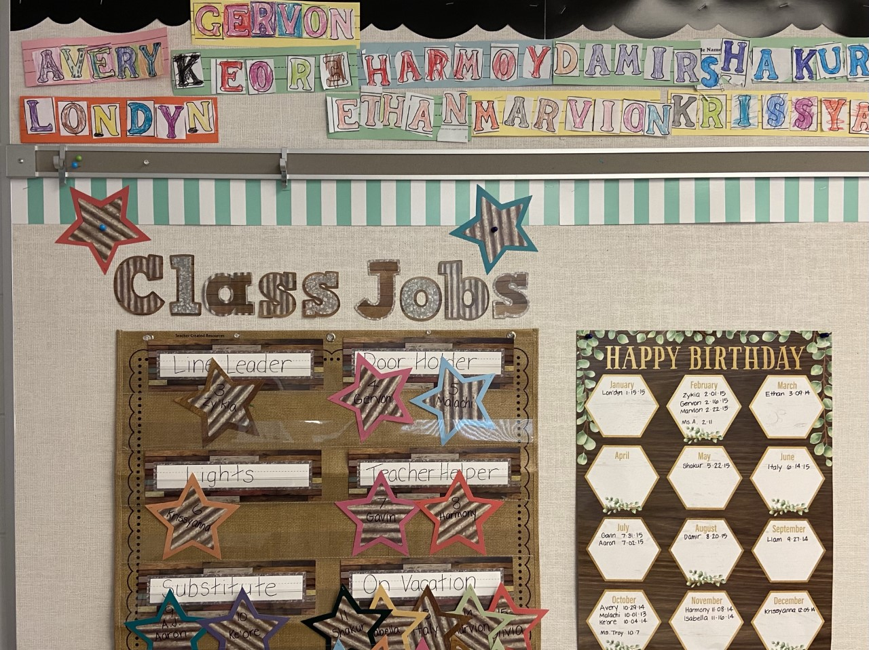
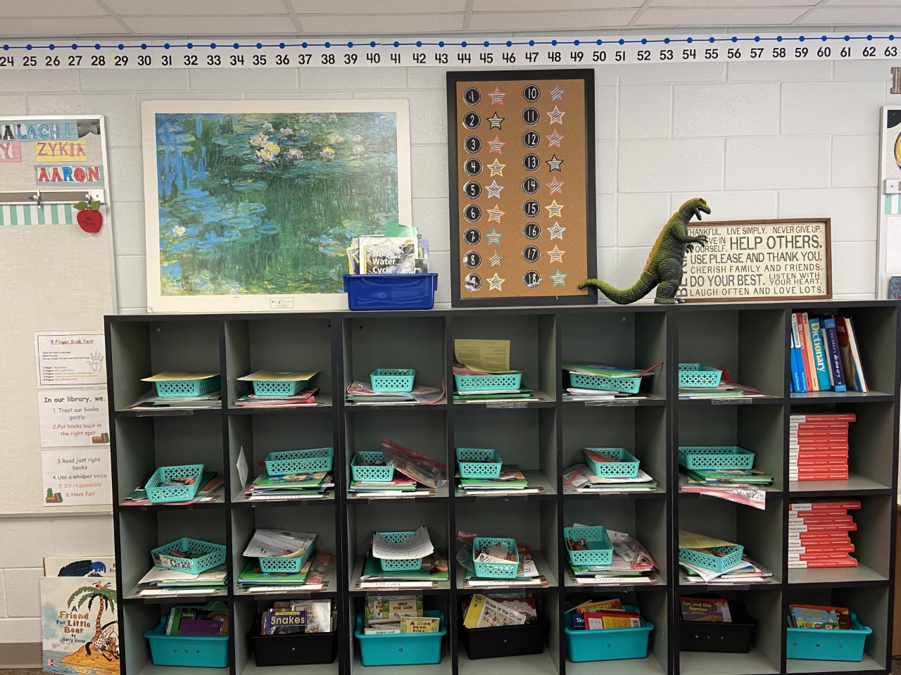
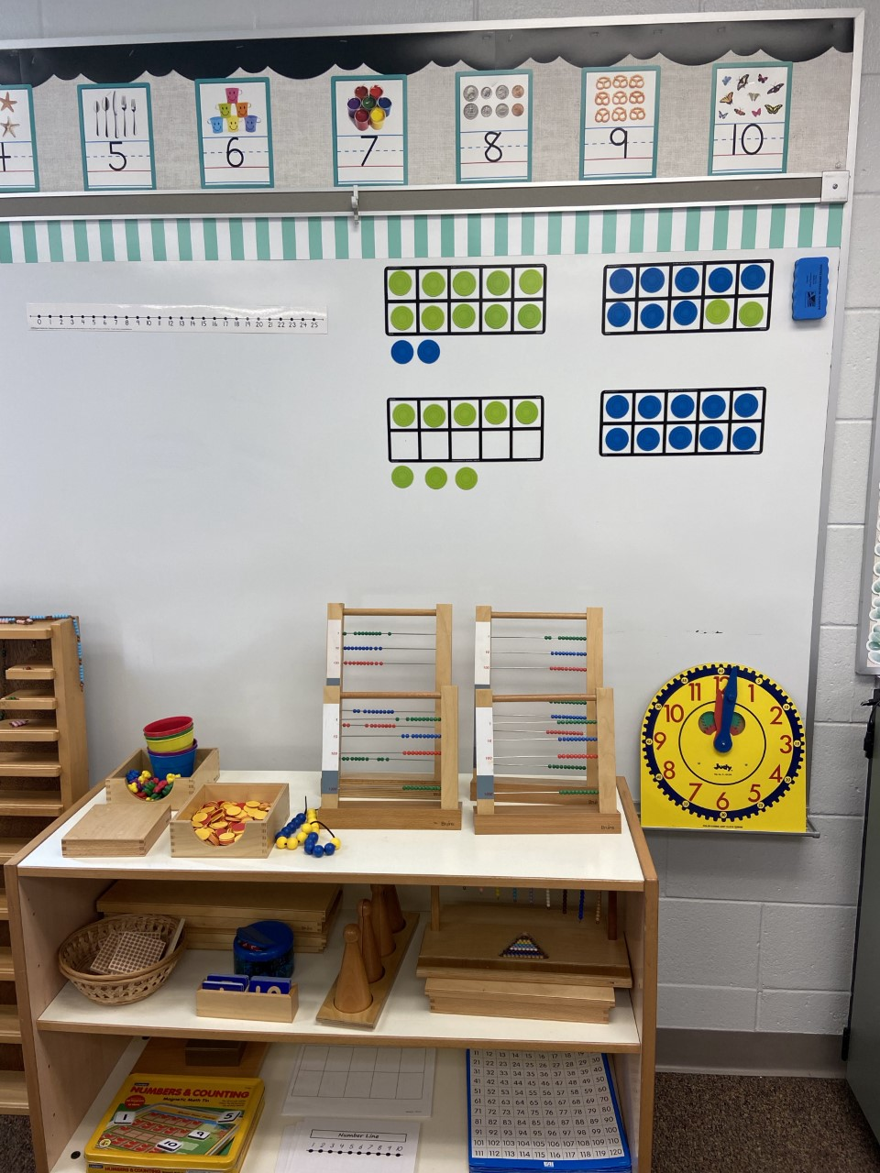
Ms. Troy’s Classroom

Slide 12
This year we will learn…
Addition and Subtraction Concepts
Addition and Subtraction Strategies
Addition and Subtraction Relationships
Counting and Modeling Numbers
Comparing Numbers
Two-Digit Addition and Subtraction
Measurement
Time
Money
Graphs
2D and 3D Shapes

Slide 13
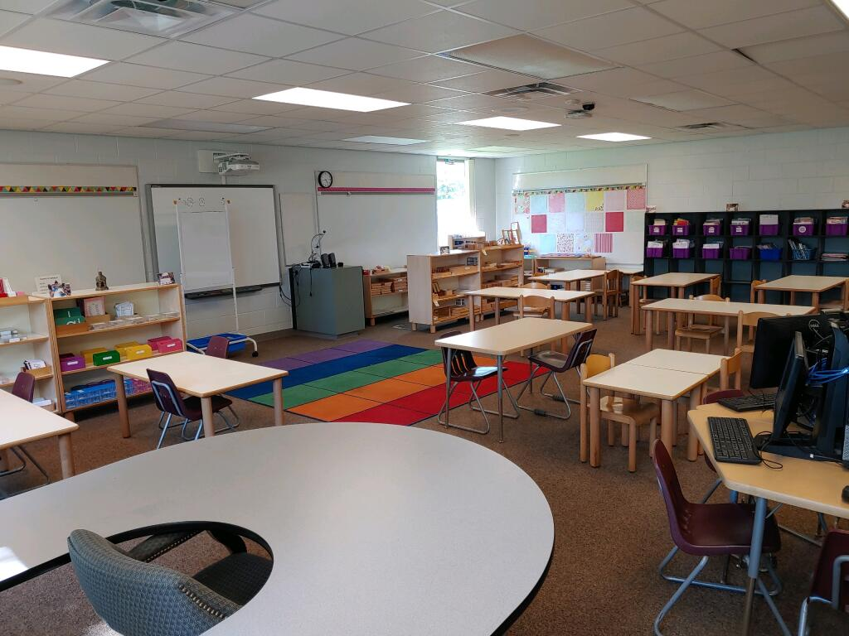
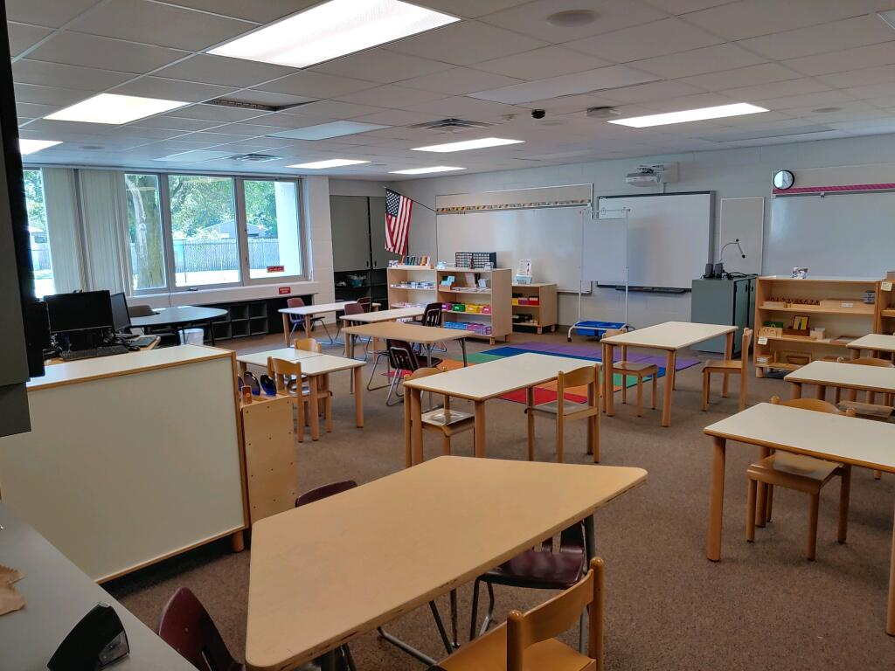
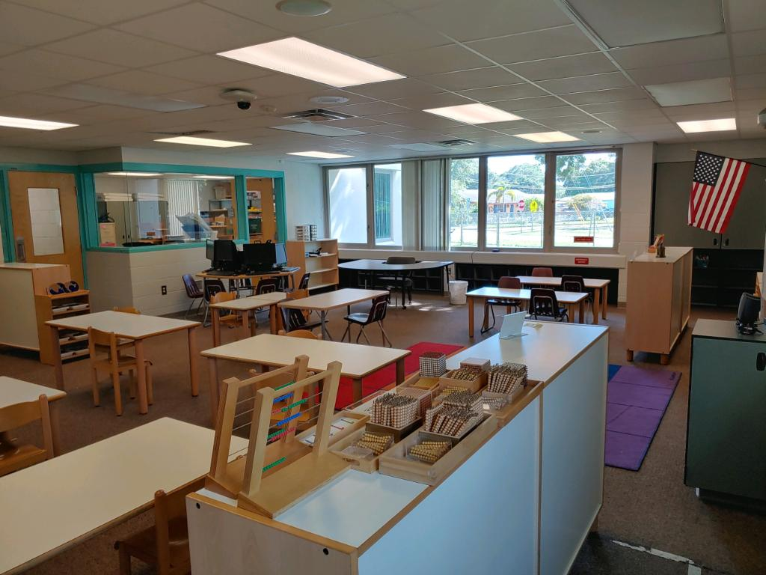
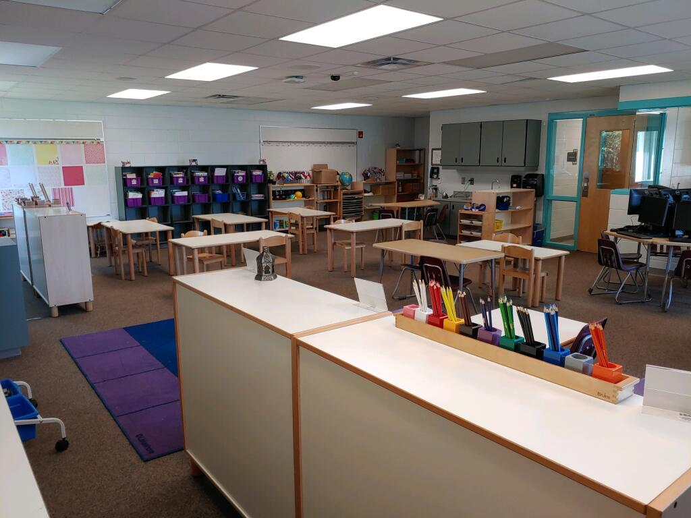
Ms. Killian’s Classroom

Slide 14
This year we will learn…
Life Science
Using Your Senses
Living and Non-Living
Basic Needs
All About Plants
Family Traits
Physical Science
Sort it Out
Changing Motion
Pushes and Pulls
Earth Science
Stars in the Sky
Gravity Works
Sunny Days
Look Around
Water Watch
Great Happenings

Slide 15
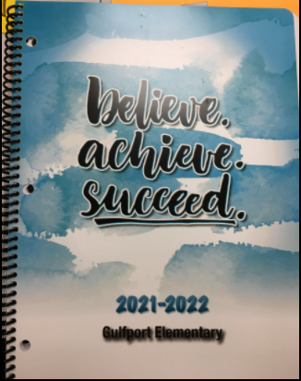
Class Dojo and Agenda
Please contact your scholar’s teacher regarding the use of Class Dojo or the School Agenda in their classroom.

Slide 16
Please feel free to contact us:
Mrs. K-B: king-byrnesy@pcsb.org
Mrs. Bohrnsen: bohrnsenk@pcsb.org
Ms. Killian: killiani@pcsb.org
Ms. Troy: troyt@pcsb.org
Ms. McCallister: mccallisterm@pcsb.org
Have a Great Evening!

