Slide 1
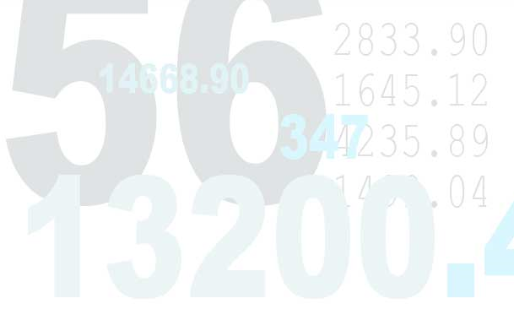
Economic Math Essentials

Slide 2
The text of this publication, or any part thereof, may not be reproduced or transmitted in any form or by any means, electronic or mechanical, including photocopying, recording, storing in an informational retrieval system or otherwise except in the course of conducting a registered Stavros Institute class or with permission of the publisher.
No part of this PowerPoint may be reprinted without written permission of the Pinellas County School Board, Pinellas County, Florida
Printed June 2015

Slide 3
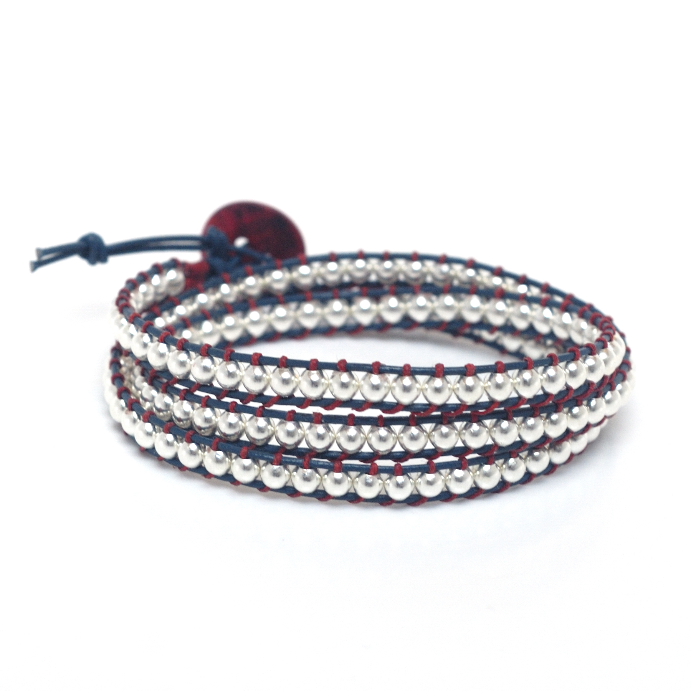
Enterprise Village – Economic Math Essentials
Lauren spoke with her mom about philanthropy and raising money by selling bracelets to give to the SPCA. She made 53 bracelets and sold them for $2.35 each. If she sells all of her bracelets, how much money will she have to give to the SPCA?

Slide 4
Enterprise Village – Economic Math Essentials
Jenica wants to go to the movies with her 2 friends and pay for their tickets as well as her own. If each ticket costs $9.50, does she have enough money if she pays with a twenty dollar bill? Explain your answer.

Slide 5
Enterprise Village – Economic Math Essentials
Grayson went to Busch Gardens and spent a total of $43.76. Michael went and spent two times as much as Grayson. Ben went with them and spent 5 dollars less than Michael. How much money did Ben spend? Draw a diagram to explain your calculations.

Slide 6
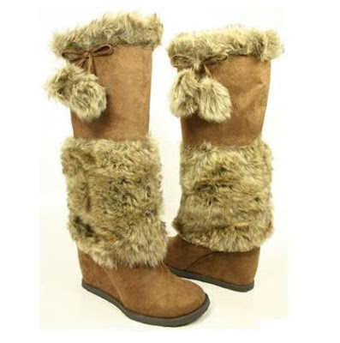
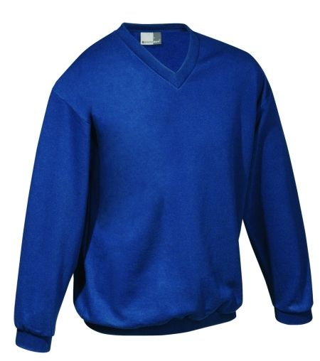
Enterprise Village – Economic Math Essentials
Ava wanted to buy a new outfit for the winter weather. She wanted to buy a new pair of jeans that costs $23.95, a pair of boots that costs $43.56, and a sweater that costs $22.83. If she pays with $100 bill, will she get change back? If so, how much?

Slide 7
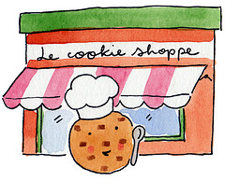
Enterprise Village – Economic Math Essentials
Sandy has a job making cookies at a cookie shop. She works 40 hours a week and makes $9.40 an hour. How much money does she make each week?

Slide 8
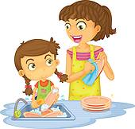
Enterprise Village – Economic Math Essentials
Finn accidentally broke his dad’s picture frame. It will cost $12.00 to replace the frame. If his mom pays him $1.10 to wash the dishes, how many times will he have to wash the dishes in order to have enough money to replace the frame?

Slide 9
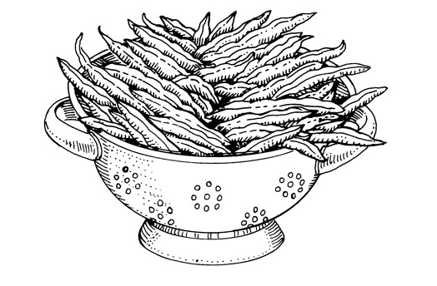
Enterprise Village – Economic Math Essentials
Rene wants to buy 3 pounds of green beans. If she goes to the store and sees they cost $2.39 a pound, about how much money will the beans cost? Explain your estimate.

Slide 10
Enterprise Village – Economic Math Essentials
How much will the Magic Island Fantasy Park collect for 12 single-day tickets
and 10 two-day tickets?
There were 347 people at a $150-a-plate dinner to raise money for charity. Expenses were $5,000.00. What is the amount that actually went to the charity?

Slide 11
Enterprise Village – Economic Math Essentials
How much will the Magic Island Fantasy Park collect for 12 single-day tickets
and 10 two-day tickets?
Elijah decided to ride in the Adopt-A-Pet Bike-A-Thon. He was able to get 53 people to sponsor him. Twenty-eight sponsors pledged $0.15 per mile. The others pledged $0.25 per mile. Elijah rode 20 miles in the Bike-A-Thon. How much money did he raise for the Adopt-A-Pet charity?

Slide 12
Enterprise Village – Economic Math Essentials
Sergio makes lemonade. He plans to use the profit for the Ronald McDonald House. If it costs $9.38 to make the lemonade and he sells 36 cups for $1.00 each, how much money does he make after his initial costs?

Slide 13
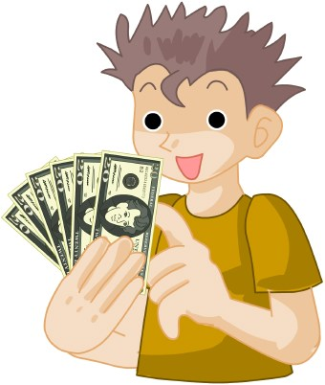
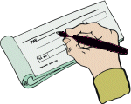
Enterprise Village – Economic Math Essentials
Alejandro had $7.25 in his checking account. After he deposited his pay check and then transferred $1.50 to his savings account, he had a balance of $11.75 in his checking account. What was the amount of the salary check that Alejandro deposited? Write an expression to show how you determined the amount of Alejandro’s check.

Slide 14
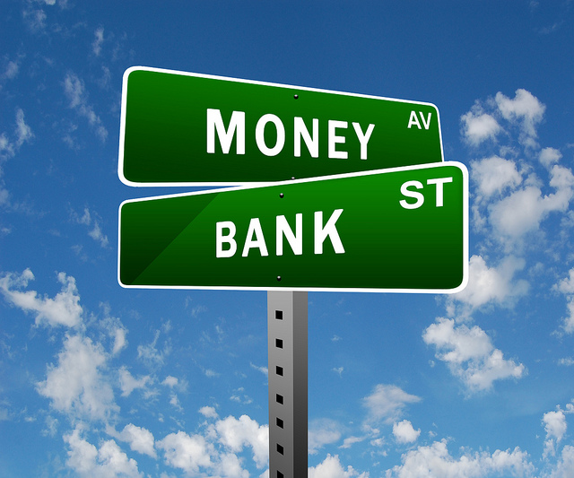
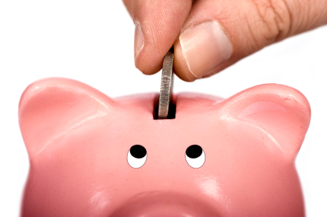
Enterprise Village – Economic Math Essentials
In May, Roddy has a total of $78.53 in his savings account. He is curious about how much interest he can earn at the bank offering an interest rate of 5% per month. How much interest will he earn for the month?

Slide 15
Enterprise Village – Economic Math Essentials
Perry has $36.77 in his checking account. He has $432.00 in his savings account. If he uses both accounts to pay for birthday presents that cost $445.00, how much money will he have left?

Slide 16
Enterprise Village – Economic Math Essentials
Jack’s mom has always told him to use the money he has in his savings account for emergencies only. His dog gets sick and he needs to go to the veterinarian. The vet bill will be $77.77. If he has $80.00 in his savings account and decides to use that money, how much would he have left?

Slide 17
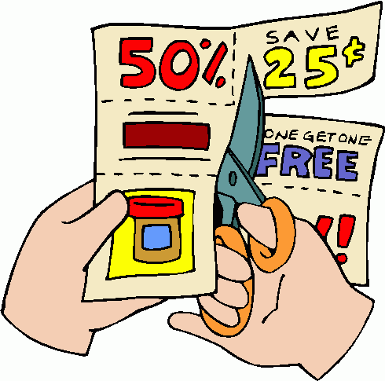
Enterprise Village – Economic Math Essentials
Here is a list of discount coupons. You do not have a calculator. Describe two ways to find the total amount you can save if you used all of these coupons.
Discount Coupons
$0.65
$0.88
$0.23
$0.42
$0.77
$0.35
$0.99
$0.15

Slide 18
Enterprise Village – Economic Math Essentials
Huge Sale – Don’t Miss It!
Body Board - $145 Wet Suit - $68
Board Bag - $65 Leash - $13
Save!!!
Buy the whole package for $275
Mitchell’s Surf and Tennis Shop is having a sale on surfing equipment. Carrie wants to purchase all four pieces of equipment separately. Kevin thinks the package price is a better deal. Does it cost less to buy the pieces separately or as a package? Show proof of your thinking.

Slide 19
Enterprise Village – Economic Math Essentials
Ricardo had $10.00 in his account. He bought a pair of binoculars for $4.75, a pair of sunglasses for $3.35, and a pen for $0.75. How much money remained in his account?

Slide 20
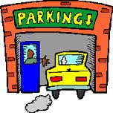
Enterprise Village – Economic Math Essentials
The Steins parked in the parking garage while they went to the circus. How much did they have to pay if they parked from 10:15 AM to 1:45 PM?
Park – Your – Car
Rate:
First hour $9.00
Each additional hour or part of an hour $6.00
Maximum $25.00

Slide 21
Enterprise Village – Economic Math Essentials
Last summer Terry worked on a tomato farm. His boss agreed to pay him $0.01 for the first plant he picked, $0.02 for the second, $0.04 for the third, $0.08 for the fourth and so on until he had picked all 12 bushes.
How much was he paid for the 12th bush? How much money did he make in all?
Would Terry earn more being paid as he was or being paid $3.00 per bush?

Slide 22
Enterprise Village – Economic Math Essentials
Shannon buys perfume when it is on sale. Which is the better buy? Sweet Nothings or Heaven Scents?
How much will she save by buying the less expensive one?
Sweet Nothings
3 oz. for $7.50
Heaven Scents
4 oz. for $9.48

Slide 23
Enterprise Village – Economic Math Essentials
How much will the Magic Island Fantasy Park collect for 12 single-day tickets and 10 two-day tickets?
Magic Island Fantasy Park
Ticket Prices
Single-day $19.95
Two-day $36.50

Slide 24
Enterprise Village – Economic Math Essentials
How much will the Magic Island Fantasy Park collect for 12 single-day tickets
and 10 two-day tickets?
Julian kept depositing pennies in a piggy bank. He added $0.01 the first week, $0.02 the second week, $0.04 cents the third week, $0.08 the fourth week, and so on. How many pennies will Julian add the tenth week? How much money will be in the jar altogether after 10 weeks?

Slide 25
Enterprise Village – Economic Math Essentials
How much will the Magic Island Fantasy Park collect for 12 single-day tickets
and 10 two-day tickets?
Justin spent $50.00 to buy tickets for the concert. Box seats are $7 each and orchestra seats are $5.00. If he buys 8 tickets, some of each kind, how many are box seat tickets, and how many are for orchestra seats?

Slide 26
Enterprise Village – Economic Math Essentials
How much will the Magic Island Fantasy Park collect for 12 single-day tickets
and 10 two-day tickets?
Mitchell wants to buy a new tire for his bicycle. It costs $19.49 including tax. Mitchell has saved $3.10. If he earns $2.25 an hour working at his uncle’s pet store, how many hours must he work in order to have enough money to buy the bike tire?

Slide 27
Enterprise Village – Economic Math Essentials
How much will the Magic Island Fantasy Park collect for 12 single-day tickets
and 10 two-day tickets?
Professor McMillian is going to buy a new IPAD. The price is $419.00 if she pays cash. If she makes monthly payments she must pay $100.00 down and $30.27 a month for 1 year. Which way of paying will cost her less? How much less?

Slide 28
Enterprise Village – Economic Math Essentials
How much will the Magic Island Fantasy Park collect for 12 single-day tickets
and 10 two-day tickets?
Chrissy went to the Super Scoop Ice Cream Shop on Saturday. She spent half her money on a cheeseburger. Then she spent $1.35 on an ice cream cone. She had $1.50 left. How much money did she have at the start?

Slide 29
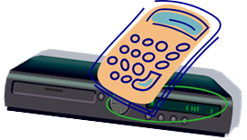
Enterprise Village – Economic Math Essentials
How much will the Magic Island Fantasy Park collect for 12 single-day tickets
and 10 two-day tickets?
Pablo bought a widescreen portable DVD player. He paid $25.00 as a down payment and agreed to pay $13.50 a month for 6 months. What was the total cost of the DVD player?

Slide 30
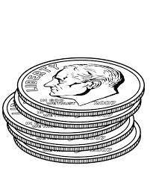
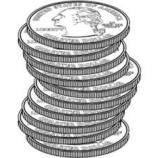
Enterprise Village – Economic Math Essentials
How much will the Magic Island Fantasy Park collect for 12 single-day tickets
and 10 two-day tickets?
Alex has $3.70 in dimes and quarters in his coin collection. He has 9 more dimes than quarters. How many quarters does Alex have?

Slide 31
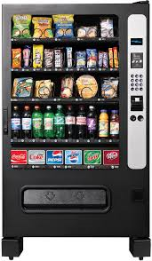
Enterprise Village – Economic Math Essentials
Chandra wants to buy a snack at the snack machine that will only accept quarters, dimes, and nickels. If each snack costs $0.35, and if she must use exact change, how many different combinations of coins can Chandra use to buy a snack?

Slide 32
Enterprise Village – Economic Math Essentials
Miguel rented a bike from Bob’s Bike Rental. He picked it up at 10:15 AM and returned it at 3:45 PM the same day. How much did it cost Miguel to rent the bike?
BOB’S BIKE RENTALS
$4.00 First hour or fraction of an hour
$3.00 Each additional hour or fraction of an hour

Slide 33
Enterprise Village – Economic Math Essentials
Marcia won a contest in June of 2015. The prize was $50.00 for each month she had been living, up to and including, June of 2015. If Marcia was born in April of 1997, how much money did she win?

Slide 34
Enterprise Village – Economic Math Essentials
Janet has $31.00 in her checking account. She uses her debit card at the store to buy a new DVD. If she has $16.22 left in her account, what was the cost of the DVD?

Slide 35
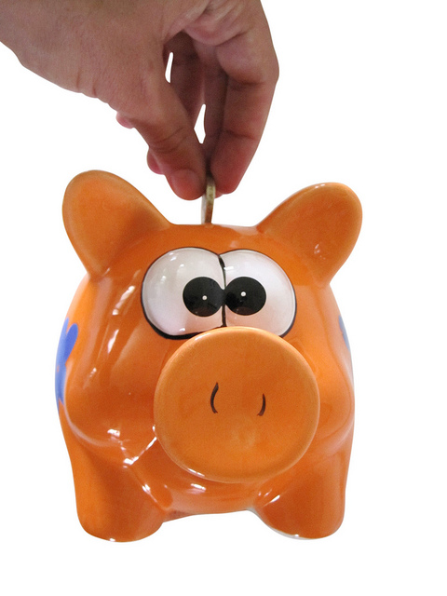
Enterprise Village – Economic Math Essentials
In December, Levi’s checking account has a total of $156.00. In January, he babysits for his sister 3 times and makes $15.00 each time. If he doesn’t spend any money, how much money will he have in his account?

Slide 36
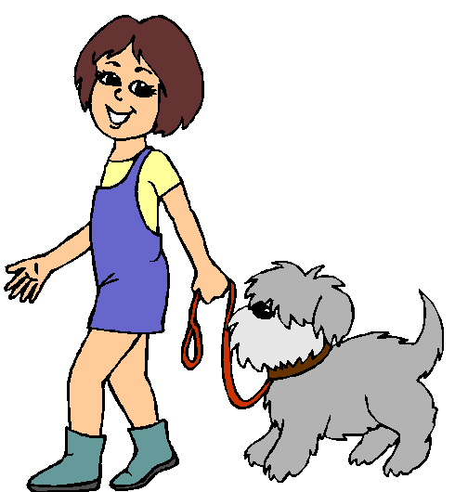
Enterprise Village – Economic Math Essentials
Susan earns $35.00 a week for walking neighborhood dogs in the month of July (4 weeks). When school starts at the beginning of the 3rd week of August, she is no longer able to walk dogs. How much money did she earn in all for walking dogs?

Slide 37
Enterprise Village – Economic Math Essentials
Ashton has a total of $503.00 in his checking account. He is trying to save some money to buy a new game system. He transfers $75.00 to his savings account. How much money remains in his checking account?

Slide 38
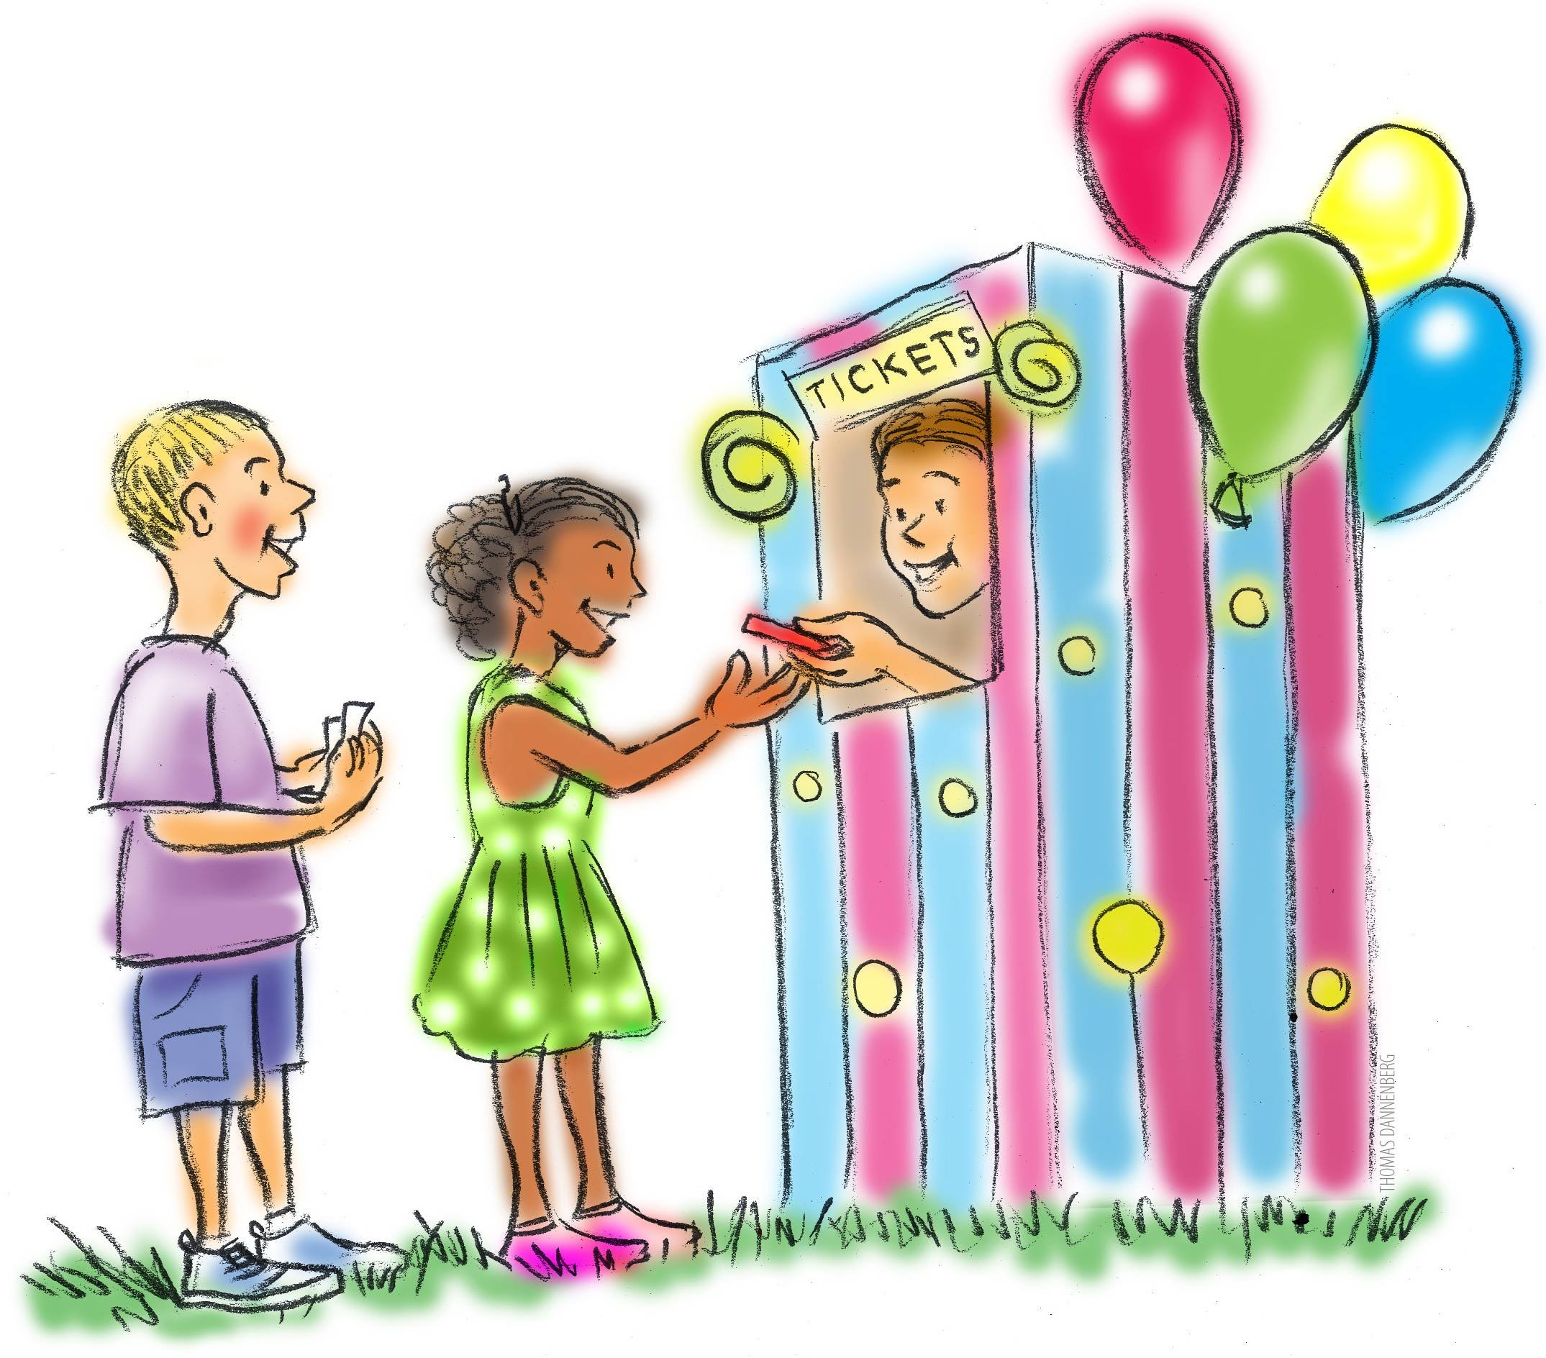
Enterprise Village – Economic Math Essentials
Tyler and Finn went to the carnival. Tyler spent $13.00 in all. Finn spent $5.00 more than Tyler. Hilary spent 3 times as much as Finn. Write an expression to represent the problem, then determine how much money the 3 friends spent in all at the carnival?

Slide 39
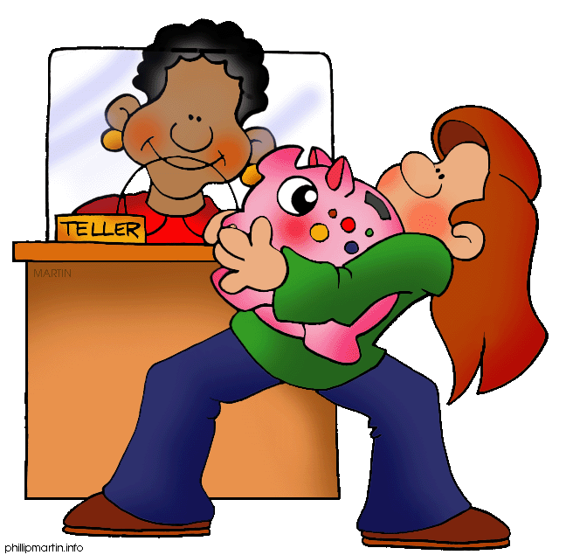
Enterprise Village – Economic Math Essentials
Lucy had $56.00 in her account in March. In June, she had five times as much money as she did in March. How much money did she have in June?

Slide 40
Enterprise Village – Economic Math Essentials
Alex has $23.39 saved up. He wants to buy Minecraft for his game system, but the game costs $75.95. How much money does he need to make in order to buy the game?

Slide 41
Enterprise Village – Economic Math Essentials
Hannah wants to get some new clothes for the 5th grade party. She has a total of $73.00. If she wants to buy a dress for $24.50, a pair of shoes for $35.89, and a necklace for $14.35, does she have enough money? If not, how much more money does she need?

Slide 42
Enterprise Village – Economic Math Essentials
If Bill has $150.00 in his savings account and he spends 1/10 of it on a new baseball glove, how much money did he spend?

Slide 43
Enterprise Village – Economic Math Essentials
Lori has about $200.00 in her bank account. She wants to take 6 friends to a football game and the tickets cost $26.00 a person. Does she have enough money? (Estimate)

Slide 44
Enterprise Village – Economic Math Essentials
Jacy has $37.00 in her checking account. She uses her debit card at the store to buy a new DVD for $17.95. Has she spent more or less than one-half of her money? Explain your thinking.

Slide 45
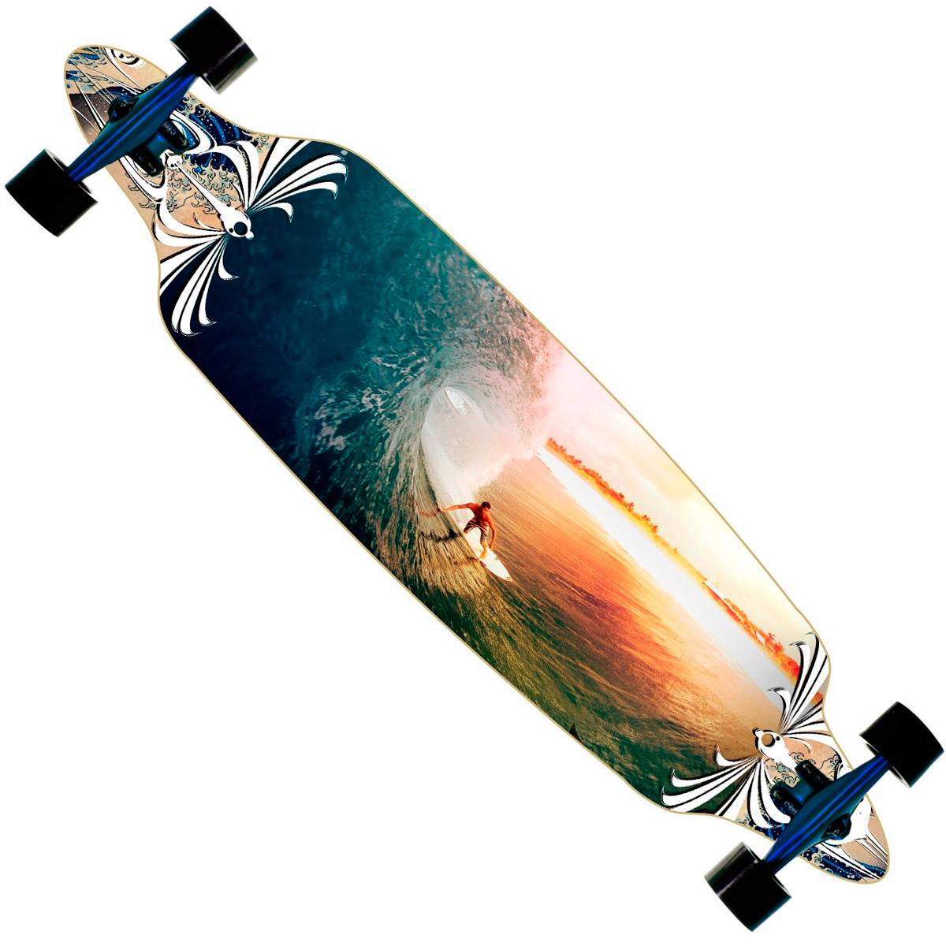
Enterprise Village – Economic Math Essentials
Phillip wants to purchase a new diamond-tail long board skateboard for $64.99. He has saved $16.00 in his savings account and makes $12.00 a day working at his uncle’s hardware store. Phillip’s mother requires him to save $1.50 out of every $24.00 he earns. How many days will Phillip need to work in order to earn enough money to purchase the skateboard?

Slide 46
Enterprise Village – Economic Math Essentials
Robbie wants to give his mom a dozen roses for Mother’s Day. A dozen roses at Grocery Mart costs $19.99. However, a single rose at Al’ s Floral Mart costs $1.50. If Robbie bought a dozen single roses at Al’s, would it be more expensive or less expensive than buying a dozen roses at Grocery Mart? Explain your thinking.

Slide 47
Enterprise Village – Economic Math Essentials
Missy has a pillow making business. She makes monster pillows that cost $2.50 each to make. If she charges $5.50 for each monster pillow, and she sells 15 pillows, what would be profit?

Slide 48
Enterprise Village – Economic Math Essentials
Leighton gives private soccer lessons. If he charges $15.00 an hour for each lesson, how many hours would it take him to make $456.00?

Slide 49
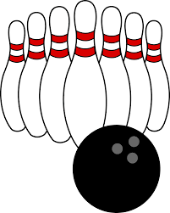
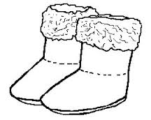
Enterprise Village – Economic Math Essentials
Determine whether the answer to each of these problems is reasonable. If an answer is not reasonable, explain why.
Striker’s Alley let you bowl 5 games for $8.85. What is the cost of each game?
Answer: The cost of each game is $1.25
Julia bought 3 pairs of boots for $78.00 and sold them for $45.00 per pair. How much profit did she make?
Answer: Julia made a profit of $57.00

Slide 50
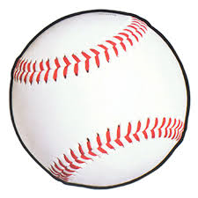
Enterprise Village – Economic Math Essentials
These problems have the numbers omitted. Identify the operation or operations needed to solve each problem. Then write an equation to solve the problems and solve them.
You can purchase individual bracelet charms at their regular price or in a special package of 6 at a sale price. How much do you save by purchasing the special package?
Hooper’s Sports Shop sold 4 times as many baseballs than All Sports. How many more baseballs did Hooper’s sell than All Sports?

Slide 51
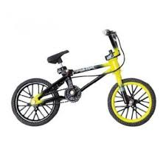
Enterprise Village – Economic Math Essentials
How much will the Magic Island Fantasy Park collect for 12 single-day tickets
and 10 two-day tickets?
If Lamont bought a mini-bike for $120, sold it for $130, bought it again for $140, and then resold it for $150, how much money did he make?

Slide 52
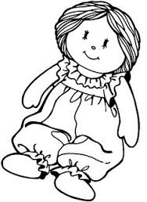
Enterprise Village – Economic Math Essentials
How much will the Magic Island Fantasy Park collect for 12 single-day tickets
and 10 two-day tickets?
At a garage sale, Jasmine bought 6 old dolls for $14.00 and fixed them up for resale. She then resold them for $3.75 each. How much profit did she make on the 6 dolls?

Slide 53
Enterprise Village – Economic Math Essentials
How much will the Magic Island Fantasy Park collect for 12 single-day tickets
and 10 two-day tickets?
Mr. Guerra wants to sell 12 baby pigs. How much should he sell each pig for if he needs to make $375.00?

Slide 54
Enterprise Village – Economic Math Essentials
How much will the Magic Island Fantasy Park collect for 12 single-day tickets
and 10 two-day tickets?
Jessica counted the cards she had for sale. She counted more than 40 cards, but less than 70. When she put them in bundles of 5, she had 1 left over. When she put them in bundles of 4, she had 1 left over. When she put them in bundles of 3, she had 1 left over. How many cards did Jessica have to sell?

Slide 55
Enterprise Village – Economic Math Essentials
How much will the Magic Island Fantasy Park collect for 12 single-day tickets
and 10 two-day tickets?
Daneshia wants to buy chocolate chip cookies at Yummies Cookie Café. They are on sale for $0.65 each, but for every 3 cookies she buys, she gets one free. Daneshia spent $3.90. How many cookies did she get for her $3.90?

Slide 56
Enterprise Village – Economic Math Essentials
How much will the Magic Island Fantasy Park collect for 12 single-day tickets
and 10 two-day tickets?
Reggie and Craig bought an old bicycle for $10.00. They decided to repair it. They spent $7.54 on a new seat, paint for $3.42 and $6.50 for a new chain. If they sold the repaired bike for $40.00 and shared the profit equally, how much money did each boy make?

Slide 57
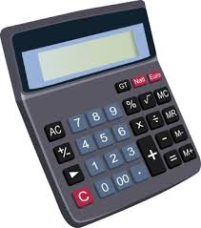
Enterprise Village – Economic Math Essentials
Mr. Whiteside, the math teacher at Lakeside School wants to buy 30 new calculators and has $400.00 to spend. The calculators regularly cost $15.75, but are on sale for $11.95 each. How much will Mr. Whiteside save by purchasing the calculators at the sale price?

Slide 58
Enterprise Village – Economic Math Essentials
The owner of the vegetable market buys apples for $0.18 each. How much does he have to sell each apple for in order to make a profit of exactly $0.45 on 9 apples?

Slide 59
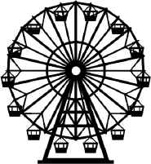
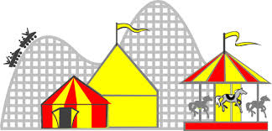
Enterprise Village – Economic Math Essentials
Chuck bought a booklet of tickets for the carnival rides at a cost $0.35 per ticket. He gave ¼ of the tickets to Blake. Then he gave half of what he had left to Sandra. After that, he had 6 tickets for himself. How many tickets were in the booklet that he bought? How much did the booklet of tickets cost Chuck?

Slide 60
Enterprise Village – Economic Math Essentials
Butler Manufacturing makes very strong storage bags from two sheets of plastic combined. When bonded together the sheets have a combined thickness of 0.05 inches. The first sheet used is 0.0345 inches thick. Which sheet is thicker? How much thicker?

Slide 61
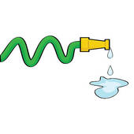
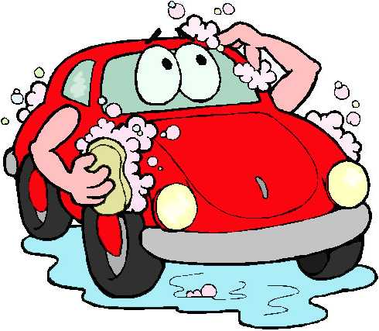
Enterprise Village – Economic Math Essentials
Erica washes cars for $10.00. This past weekend, she washed 12 cars. She charges an extra five dollars to clean the inside of the car. If she cleaned the inside of 3 of the cars, how much money did she earn this past weekend?

Slide 62
Enterprise Village – Economic Math Essentials
Lance has $2.65 in his pocket. He wants to buy candles that cost $0.32 each. How many candles will he be able to purchase? Use base ten blocks to draw a diagram to illustrate your calculations.

Slide 63
Enterprise Village – Economic Math Essentials
Laura loves milk and cookies! She wants to invite some friends over to have a party and buys 3 gallons of milk at $3.56 a gallon and 3 packages of chocolate chip cookies for $2.50 each. How much money does she spend in all?

Slide 64
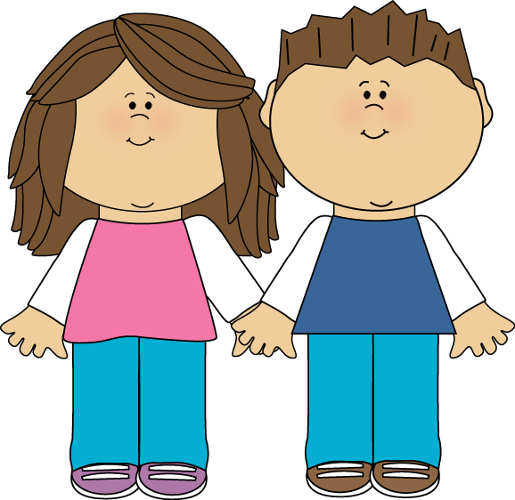
Enterprise Village – Economic Math Essentials
Zachary has 1/100 of the money his sister has. His sister has $365.00. How much money does Zachary have? Explain how your got your answer.

Slide 65
Enterprise Village – Economic Math Essentials
Darian had a balance of $76.50 in her savings account at the beginning of October. She made 3 deposits of $15.00 each during the month. On the 10th of the month, she made a withdrawal of $12.00 to buy a gift for her sister. They paid her 3% interest on her balance at the end of the month. What was Darian’s ending balance for the month?

Slide 66
Enterprise Village – Economic Math Essentials
Amy won $250.00 in an art contest. She put ½ of the money in her savings account, gave 1/10 of what remained to each of her 3 sisters, and she made a charitable donation to the “Furry Friends” project. After her donation, she had $50.00 left. How much did he donate to charity?

