Slide 1
6 Thinking Hats Activity
A routine for exploring Enterprise Village from several different perspectives.

Slide 2
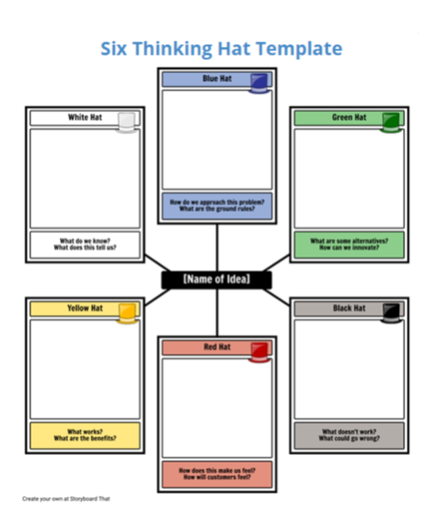
We will go over the criteria for each Hat on the next few slides.
You will meet with your business group and work through each Hat.
Finally, you will craft a PLAN OF ACTION to guarantee a successful day at Enterprise Village.

Slide 3
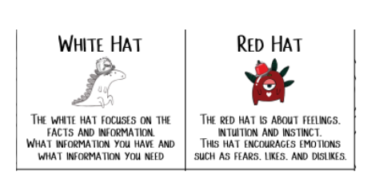
WHITE HAT: With your business group, generate a list with facts that you have learned about Enterprise Village What information do you have? What information do you need?
RED HAT: Next, what FEELINGS might come up as you work at Enterprise Village? What will you like about working in a business group? What might you dislike?

Slide 4
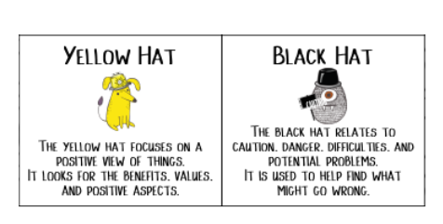
YELLOW HAT: What are the BENEFITS and POSITIVE aspects about working in a business? What VALUES should each member bring to the Enterprise Village work environment?
BLACK HAT: What DANGERS, DIFFICULTIES and POTENTIAL PROBLEMS might arise? What might go wrong?

Slide 5
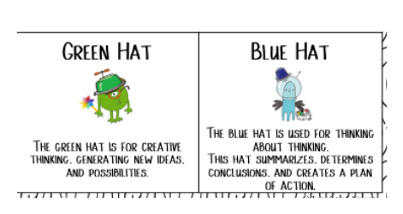
GREEN HAT: What are some NEW IDEAS or POSSIBILITIES about resolving conflict at Enterprise Village? You cannot ask your teacher or volunteer to solve your group problems repeatedly. What are some creative ways to reach agreement?
BLUE HAT: Summarize what you and your group have discussed about Enterprise Village using the 6 Thinking Hats strategy. CREATE A PLAN OF ACTION for your business to be a success!

