Slide 1
Production Activity
TOPIC: Our community and the economy.
Essential question: How does the production of goods impact consumption, and the distribution of goods and resources?

Slide 2
Student activity
Print out the PowerPoint slides and pass out to cooperative groups
Each group will act as a “Printing Business” and produce posters
Students will analyze their task by noting the constraints and demands included in each scenario
Students should note that production is connected to the distribution of goods and resources

Slide 3
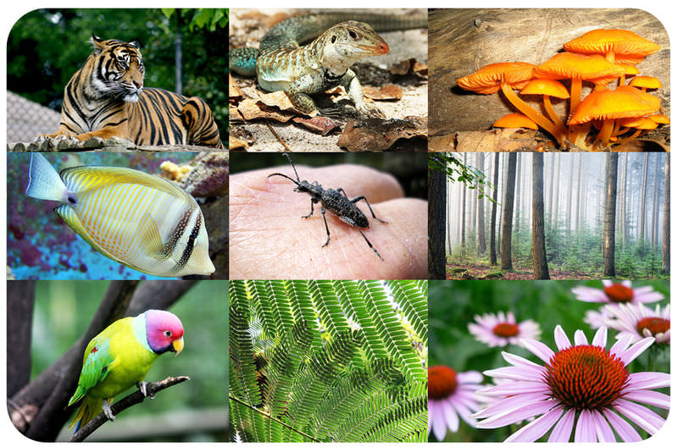
Group 1: name your printing business
You are to create posters about PLANTS or ANIMALS in your area. YOU decide what to produce and how to produce it based on your role in the group.
Posters can be shown to anyone in the community.
Divide your group into different workers:
One person or set of people will get paper from the teacher and get their OWN markers or pencils for the group to use.
One person or set of people will do the artwork.
One person or set of people will do the lettering.
One set of people will develop the idea(s) by working with the other team members.

Slide 4
GROUP 2: NAME YOUR PRINTING BUSINESS
You will create some posters.
Materials will be provided by ANYONE in the group.
Your teacher can provide paper, possibly for a fee.
You may also trade or borrow supplies from other groups.
Groups can create as many different posters as they like.
You may ask other students what you should draw or decide within the group.
You and your consumers decide what to make and how to make them.
Display the posters in the classroom as desired.

Slide 5
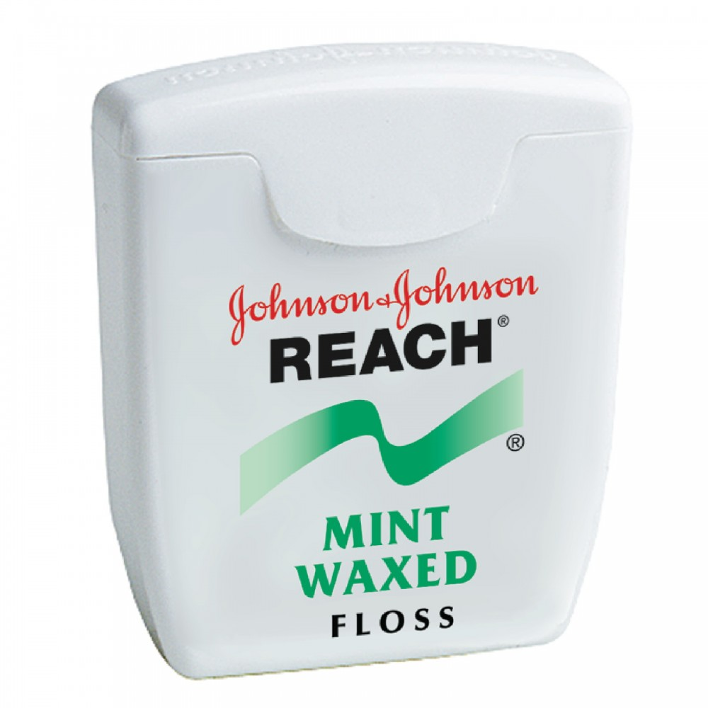
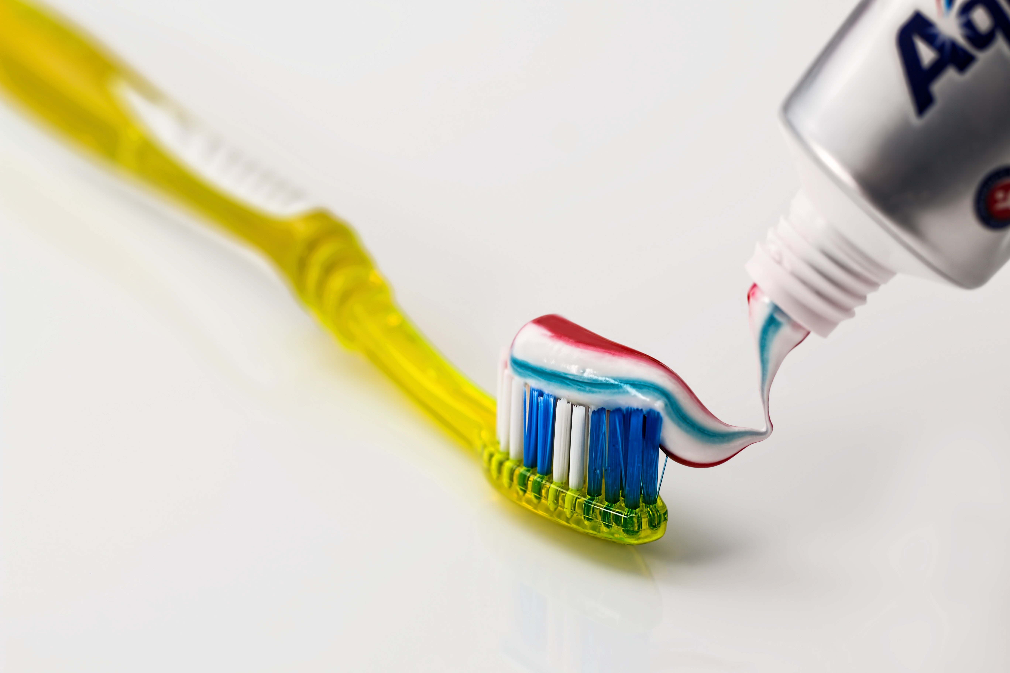
GROUP 3: YOUR PRINTING BUSINESS IS NAMED: STATE PRINTING BUSINESS
Your group will create 6 posters using ONLY classroom-provided materials:
6 sheets of paper
5 markers
Posters are to be displayed by teacher for benefit of classroom.
CONSTRAINTS:
All lettering needs to be 1” (one inch) high and ALL CAPS
You may NOT use the color red
Each student or pair of students is to work on ONE poster:
Make 3 EXACT copies of a bicycle safety poster that includes helmets and traffic lights
Make 3 EXACT copies showing the benefits of good dental hygiene, including dental floss, toothpaste, and the proper way to brush your teeth.

Slide 6
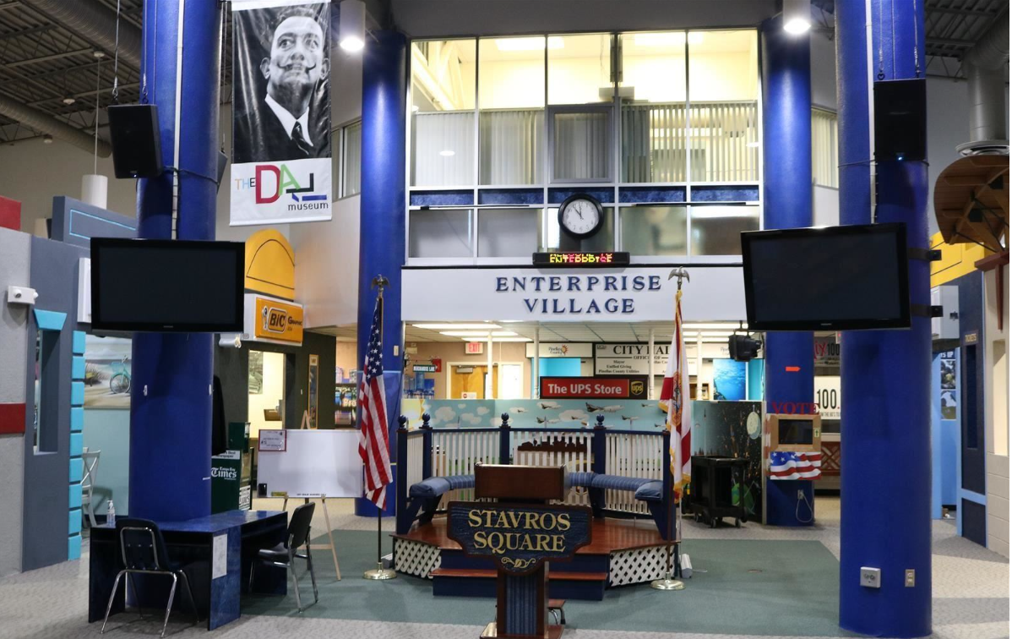
Group 4: name your printing business
Your group will create at least 2 posters about a topic you have been studying to prepare for Enterprise Village: checks, debit cards, bank accounts, savings accounts, job applications, etc.
All posters should include the title Enterprise Village
You will be given 5 sheets of paper and some markers, but you can also use your own materials OR trade with other groups
ALL writing should be done by someone who is left-handed or can use their left hand.
You decide where and how to display the posters.

Slide 7
Discussion questions post activity
How does the supply of goods affect production?
Which printing company had the most detailed advertising? Justify your thinking.
Which printing company had the least most detailed advertising? Why do you think this is?
How does the economy depend on the production and distribution of goods?
Which printing business had the most freedom when producing a good?
Which printing business had the most constraints?
How did the activity compare and contrast amongst the printing groups?
Predict which printing group will reach the most customers. Why do you think this?
Which printing business had the most economic freedom?

