Slide 1
Welcome To 4th Grade
Mrs. Pagliaro
Mrs. Loguercio
Ms. Jimenez
Mrs. Daniels

Slide 2
Class Rules
Listen when your teacher is talking
Keep your hands, feet and objects to yourself
Take care of the classroom and all items in it
Follow directions quickly
Be kind and honest
Be a learner, not a finishe

Slide 3
Classroom Behavior
PBIS School Wide Expectations
Whole School Common Language – PRIDE
Perserve
Respect yourself, others and property
Improve everyday
Do your best
Exhibit self-control

Slide 4
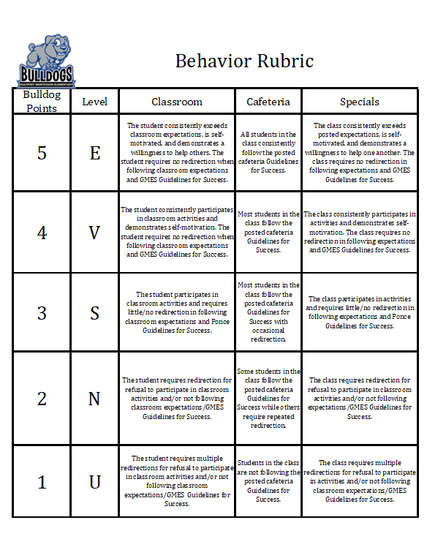
Schoolwide Behavior Plan

Slide 5
Daily Schedule Arrival routine (8:00-8:20) 8:00 – gates open 8:00-8:20 – breakfast; if they finish early, they go to their holding area (art room) 8:20 – teacher pick-up Morning work (8:20-8:40) Morning work and announcements Usually a writing prompt or review problem Specials (8:40-9:30) – music, art, P.E. Magic hour (9:30-10:30) Intervention time – meeting students where they are at and helping fill in the gaps to get them to grade level M-W – reading; Th-F – math Math or Reading (10:30-11:40) Whole group, check for understanding, independent/small group, exit ticket Science /Writing (11:40-12:30) Recess (12:35-12:55) Lunch (12:55-1:25) Repeat!

Slide 6
Dismissal
R’Club, Walkers and Bus – Daniels and Pagliaro
Car Riders – Jimenez and Logrecio
Students walk to their holding area with the assigned teacher, sit and wait for their name/bus to be called.

Slide 7
Homework
ELA, Writing, Math and Science Homework is assigned according to the teacher 2-4 times a week based on the needs of each scholar.

Slide 8
Grading
Assignments are graded every week.
If all their work is finished, they can earn Friday choice time
Late work is accepted until the end of the grading period unless noted differently. Grade every Thursday
If all their work is finished, they earn Friday choice time
Late work is accepted until the end of the grading period.

Slide 9
Communication
Parents are contacted through scholar agenda books, phone calls, email, class dojo or text message. If you need to contact your scholar teacher, please use one of these methods.

Slide 10
4th grade Assessments
Triweekly Assessments
End of Unit Assessment
ELA FSA
I-Ready Assessments
Math FSA
Writing FSA

Slide 11
Attendance
Attending school every day is IMPORTANT If you are not feeling well or exhibiting COVID like symptoms, please stay home and contact the front office to receive information.

Slide 12
Open communication
Let us know if there is anything that we can do to support your student and help them to succeed.

